Slide 1


Phisics 2
Md Mukhlesur Rahman
BSc (Hon’s) M.Sc (Chemistry) M.Ed
Instructor (Non-Tech)

Slide 2
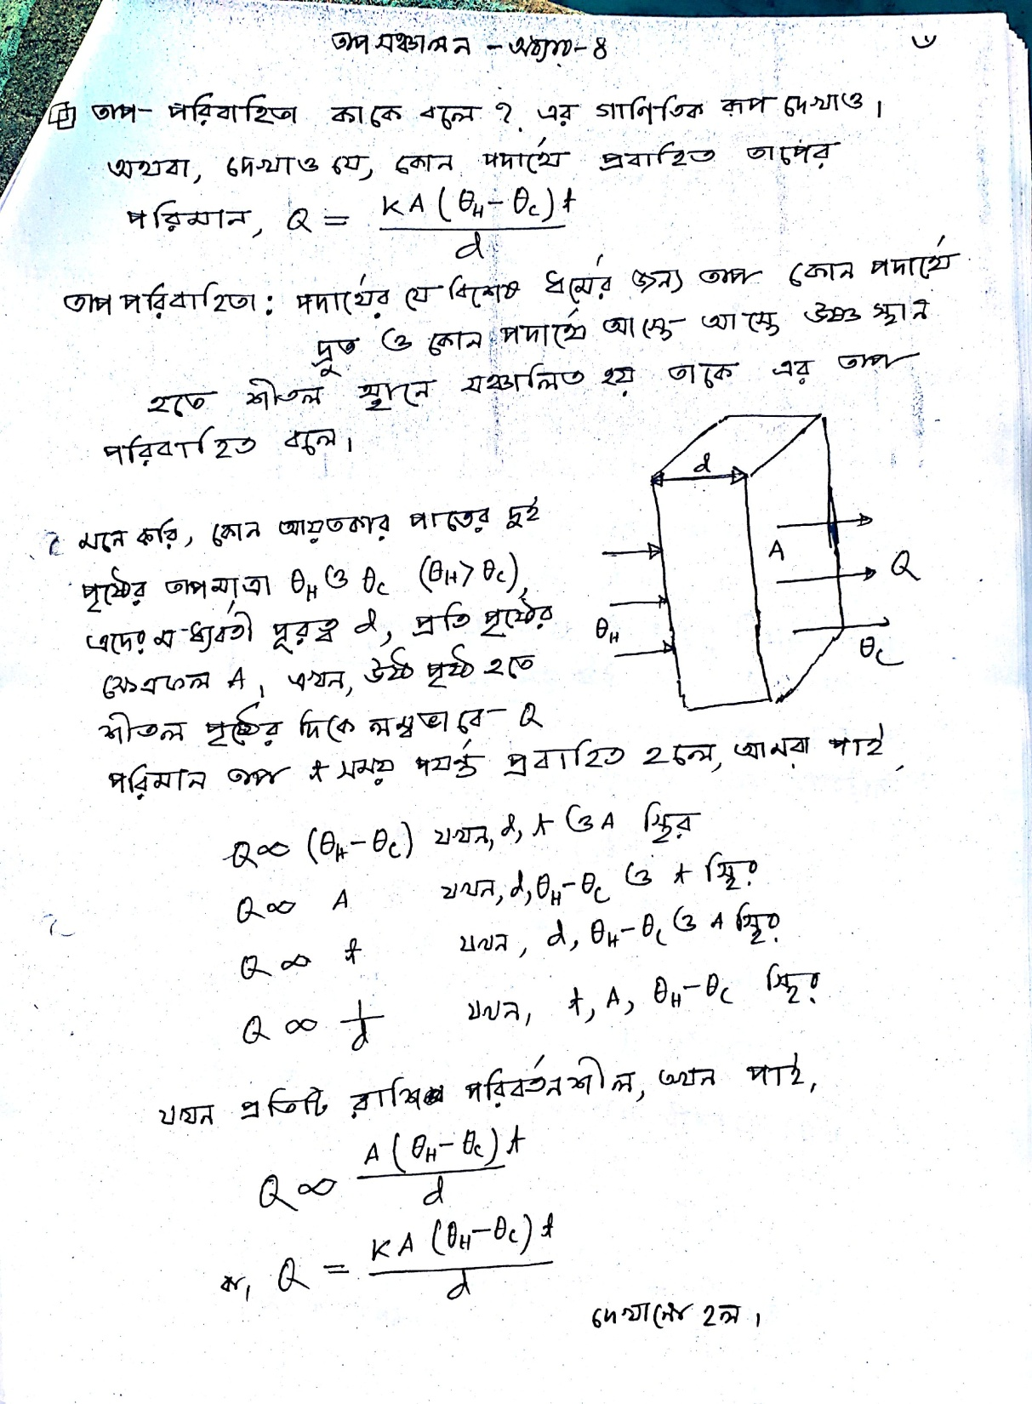

Slide 3
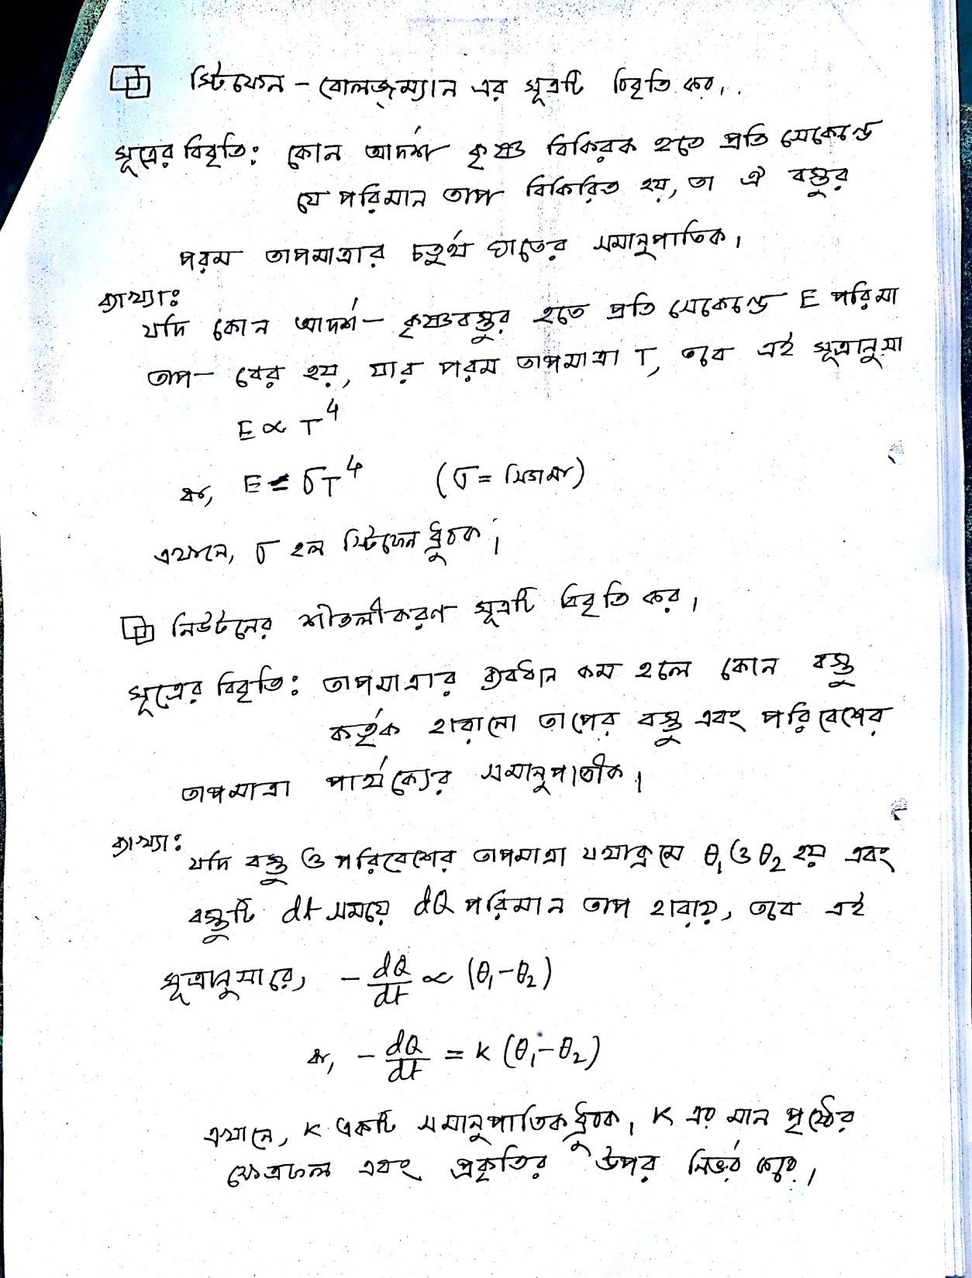

Slide 4
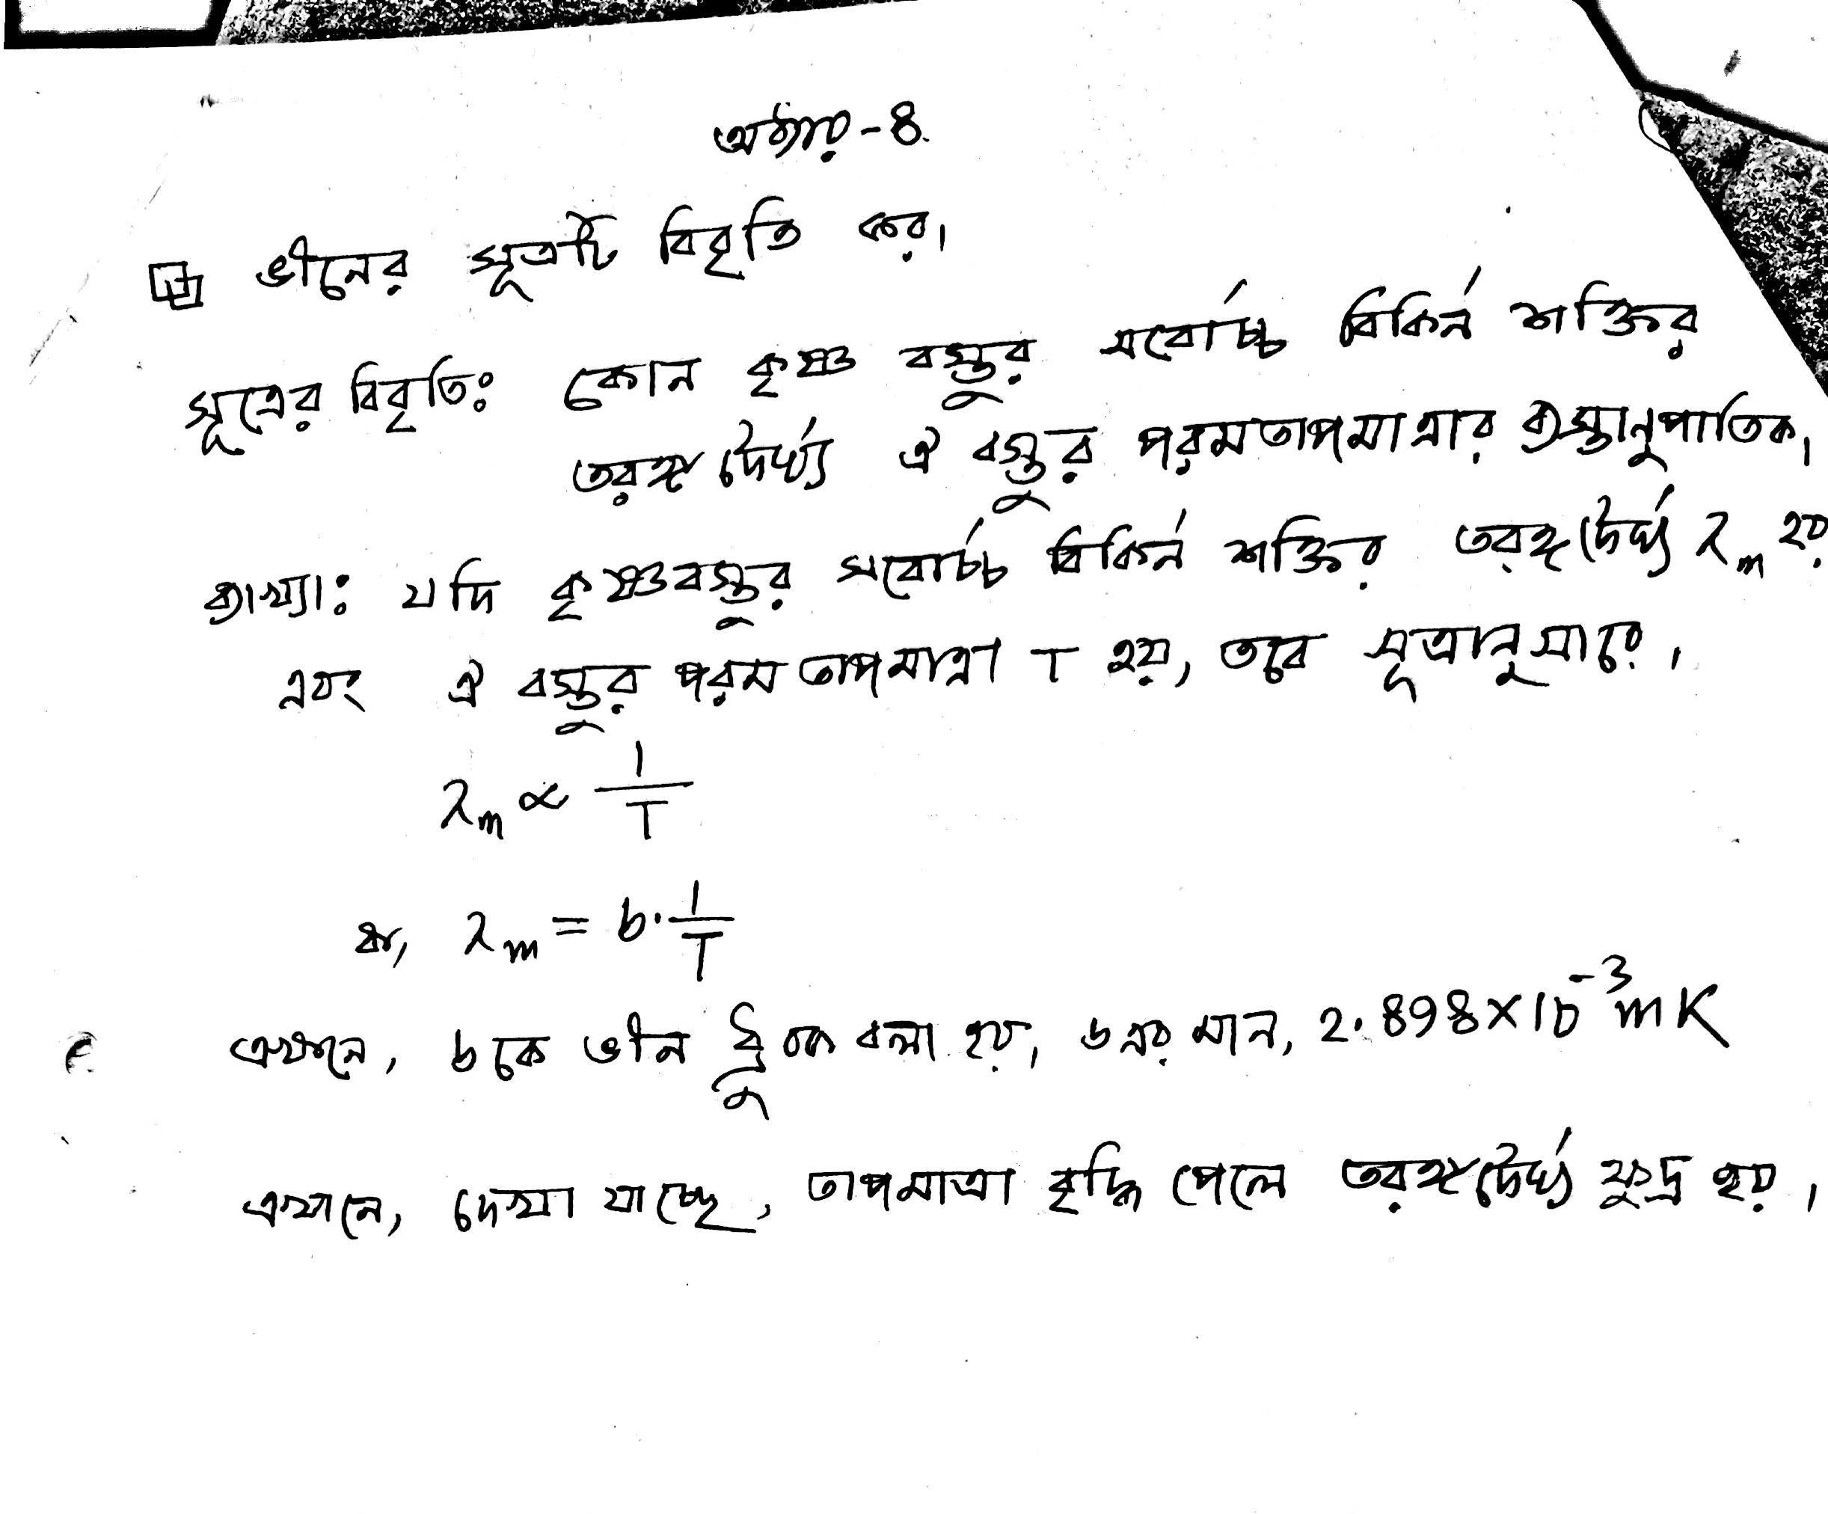

Slide 5
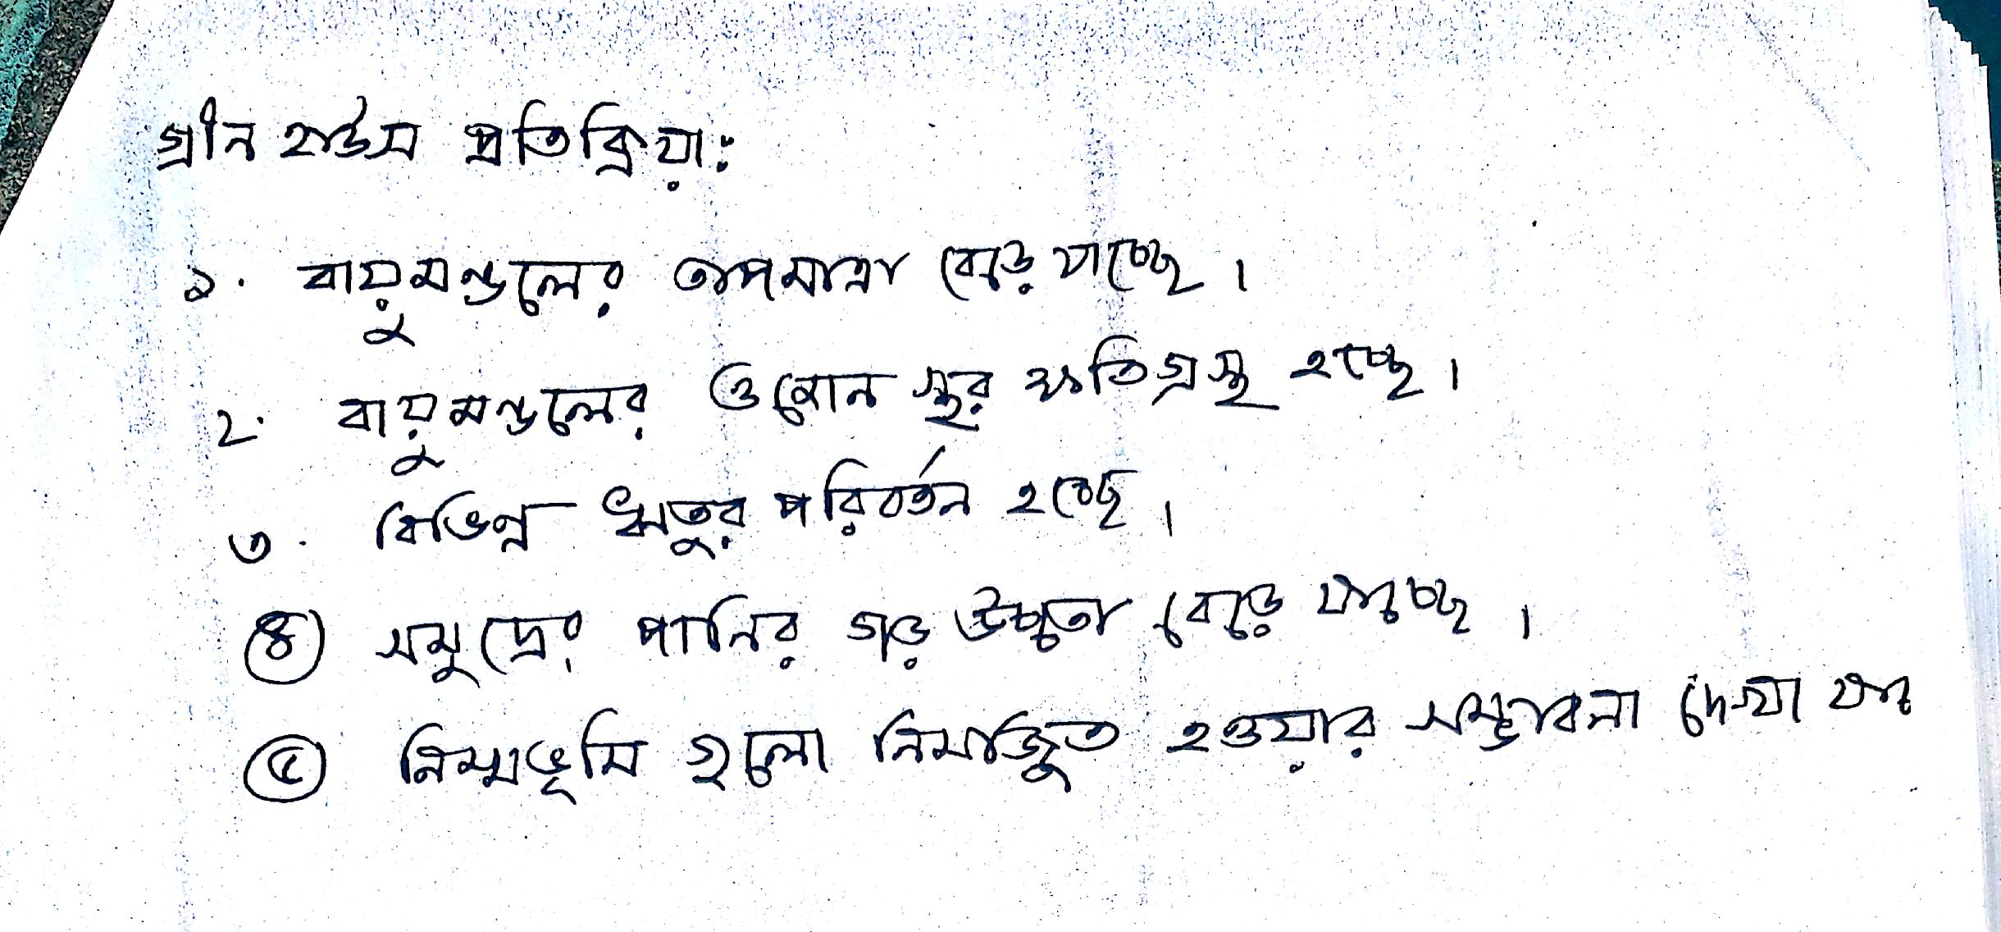

Slide 6
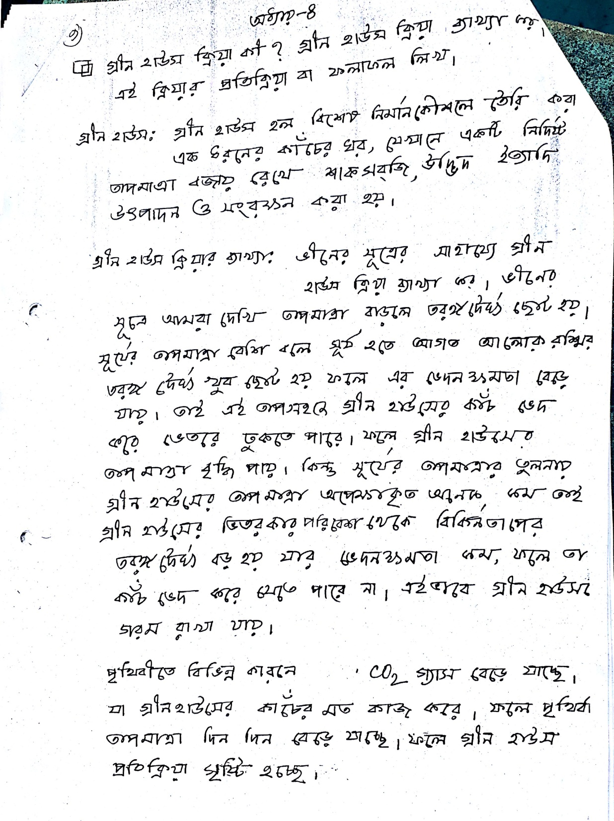

Slide 7

Rfresh
Thank You

