Slide 1
Phisics 2
Md Mukhlesur Rahman Kanon
B.Sc Hon’s M.Sc (Chemistry) M.ED
Instructor (Non-tech)

Slide 2
Chapter 1 Thermomity
Heat & Temperature
The units of heat and temperature
Different units of temperature
Different between heat and temperature
Construction and graduation of mercury thermometer.

Slide 3
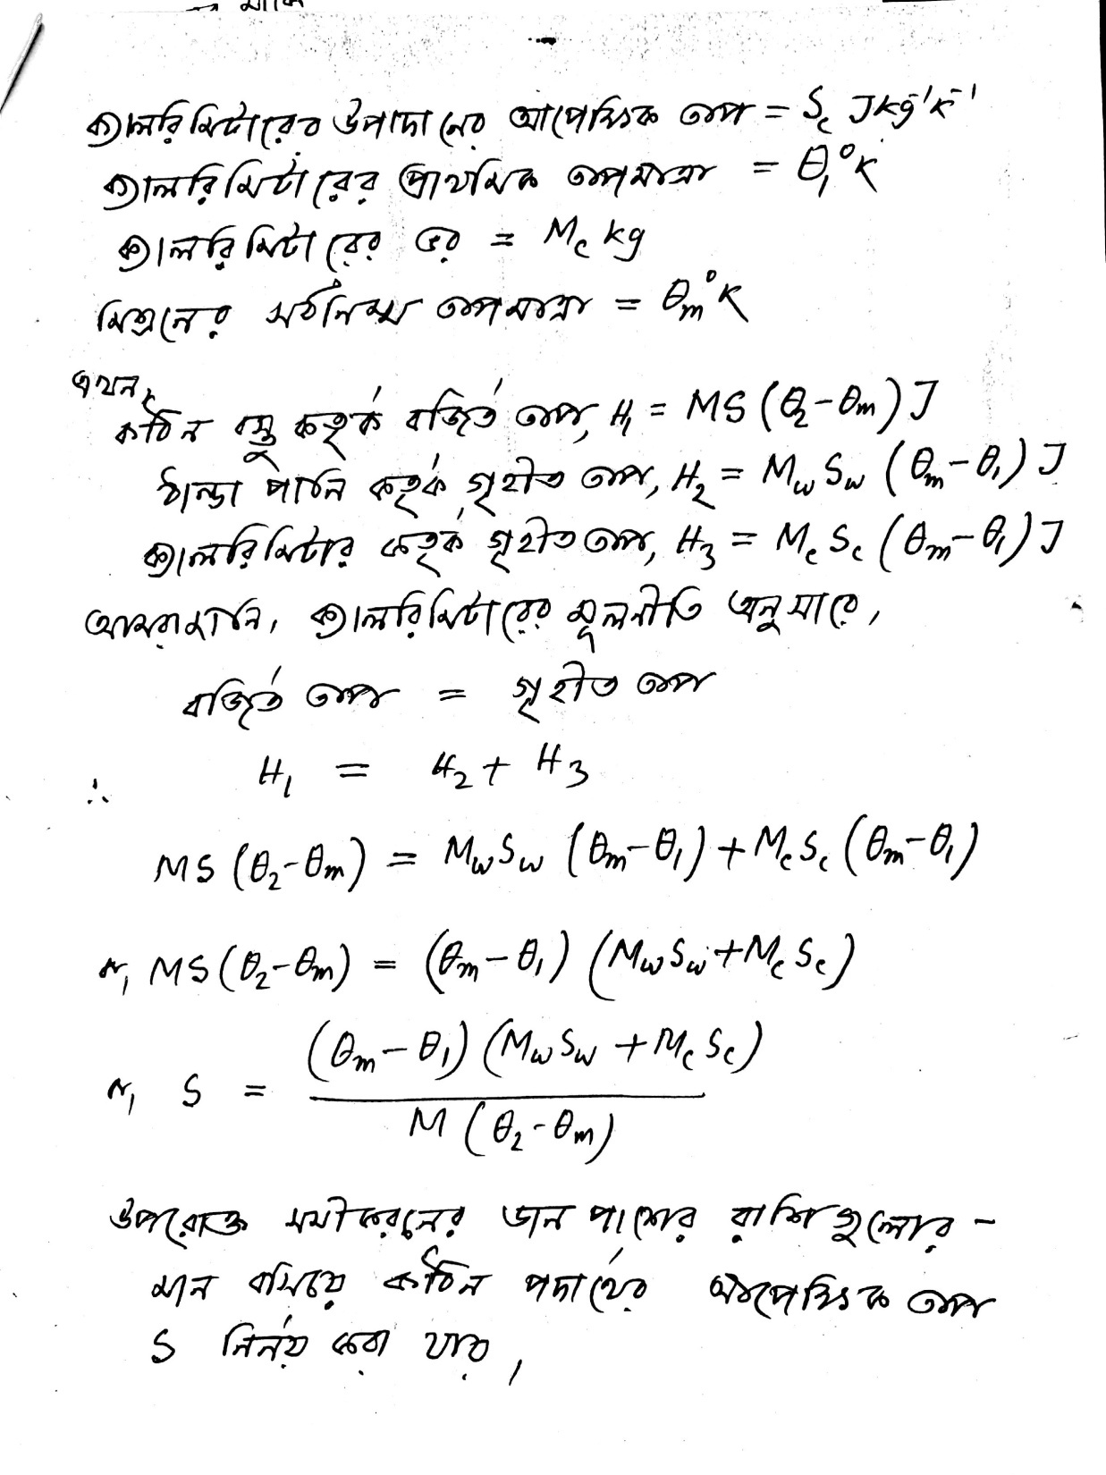
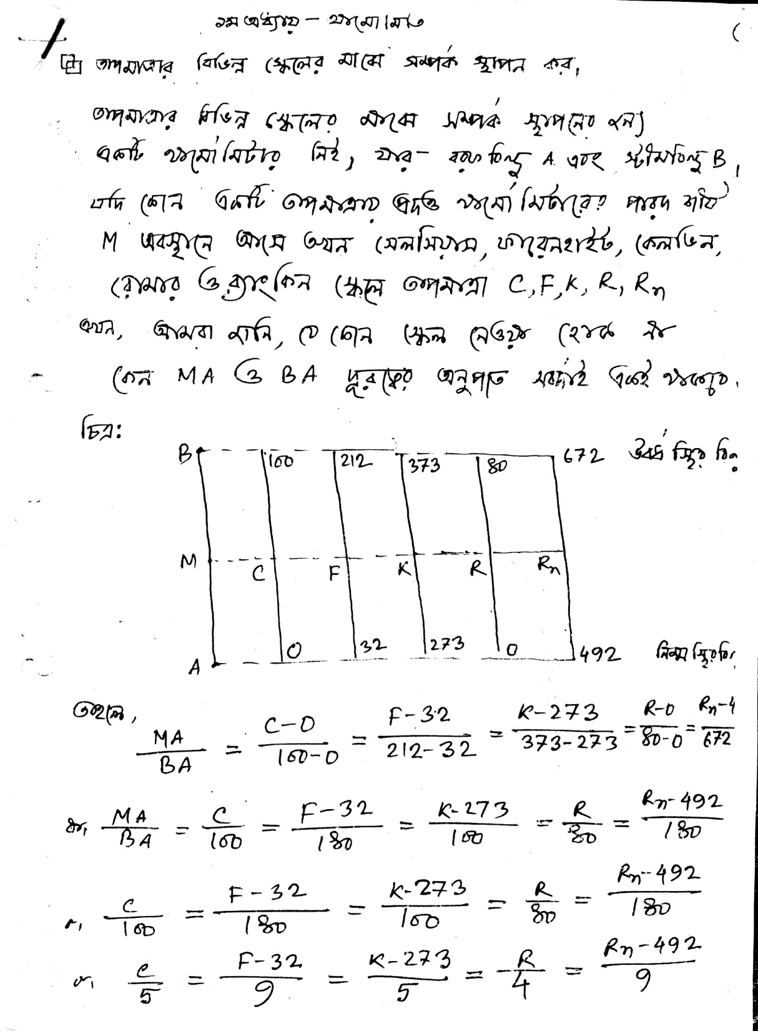

Slide 4
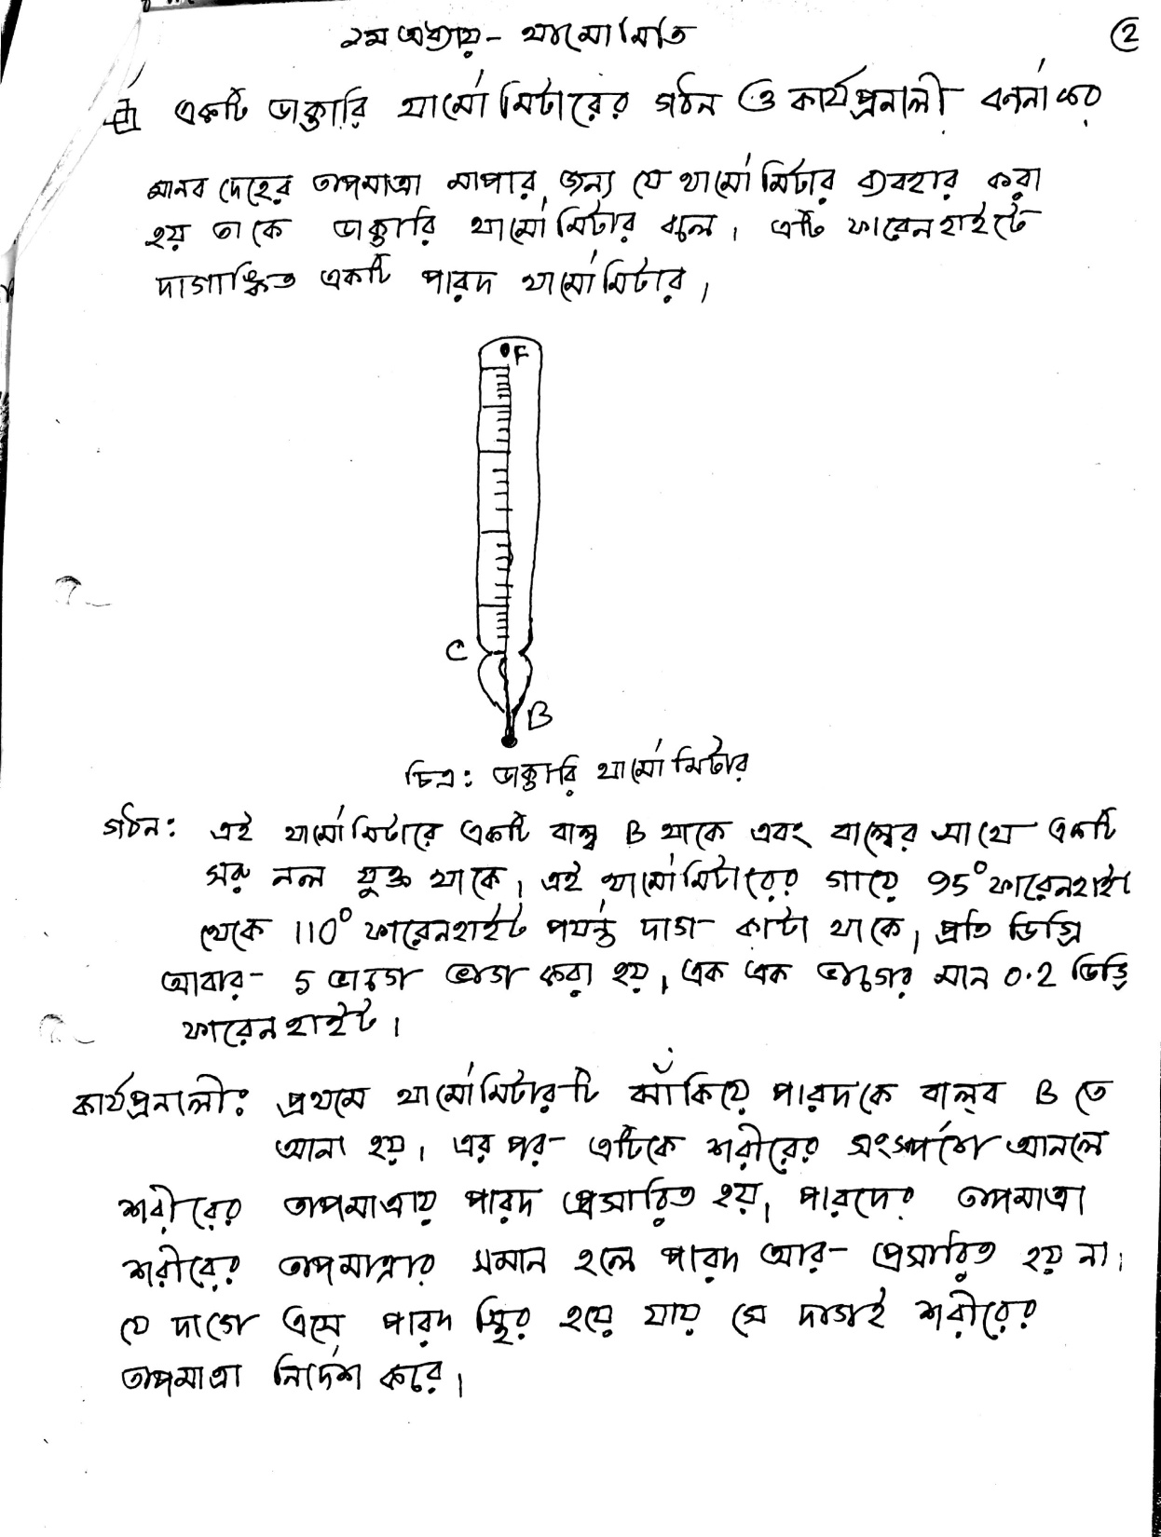

Slide 5
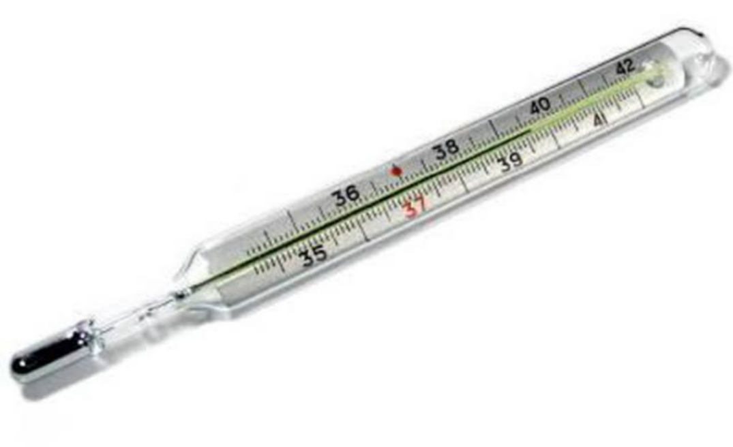

Slide 7
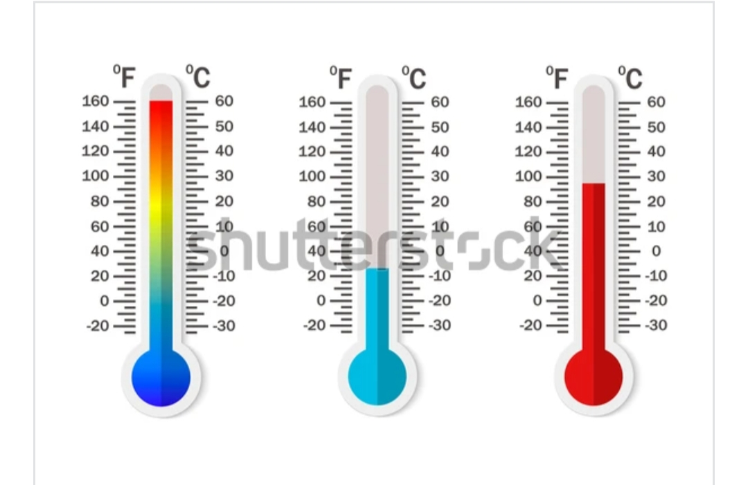

Slide 8
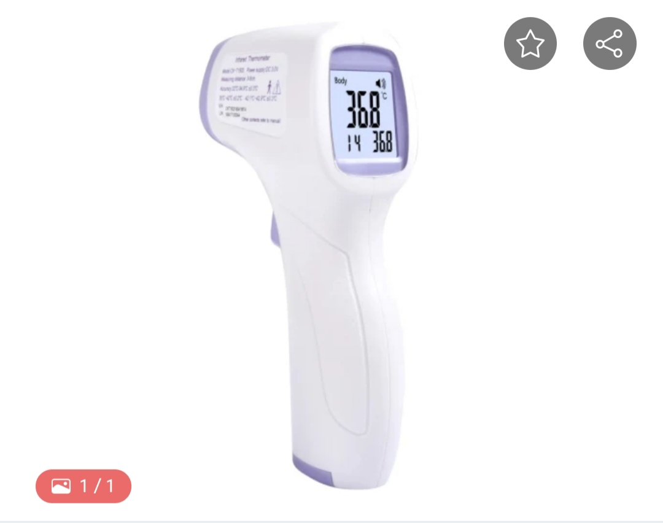

Slide 10
