Slide 1

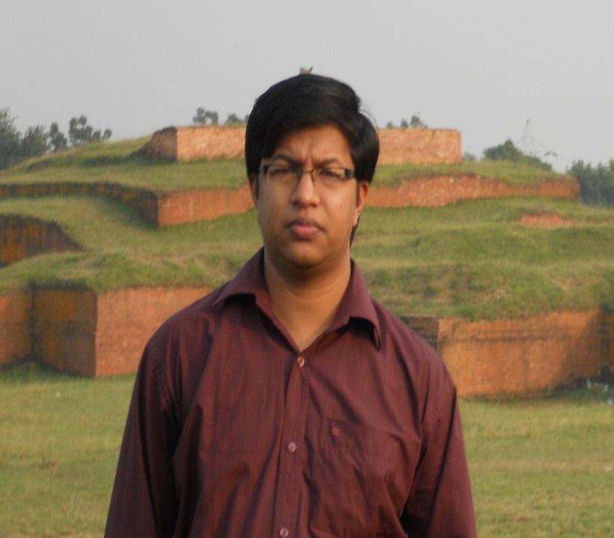
Welcome to my
Presentation
BANGLADESH SURVEY INSTITUTE

Slide 2

Presentation on
Mathematics-2
Subject code: 25921
Presented by
SUMAN CHAKRABORTY
Instructor (Non-Tech)Math

Slide 3
Chapter no -2
Presentation ON –Exponential Serise
(m~PK aviv)

Slide 4
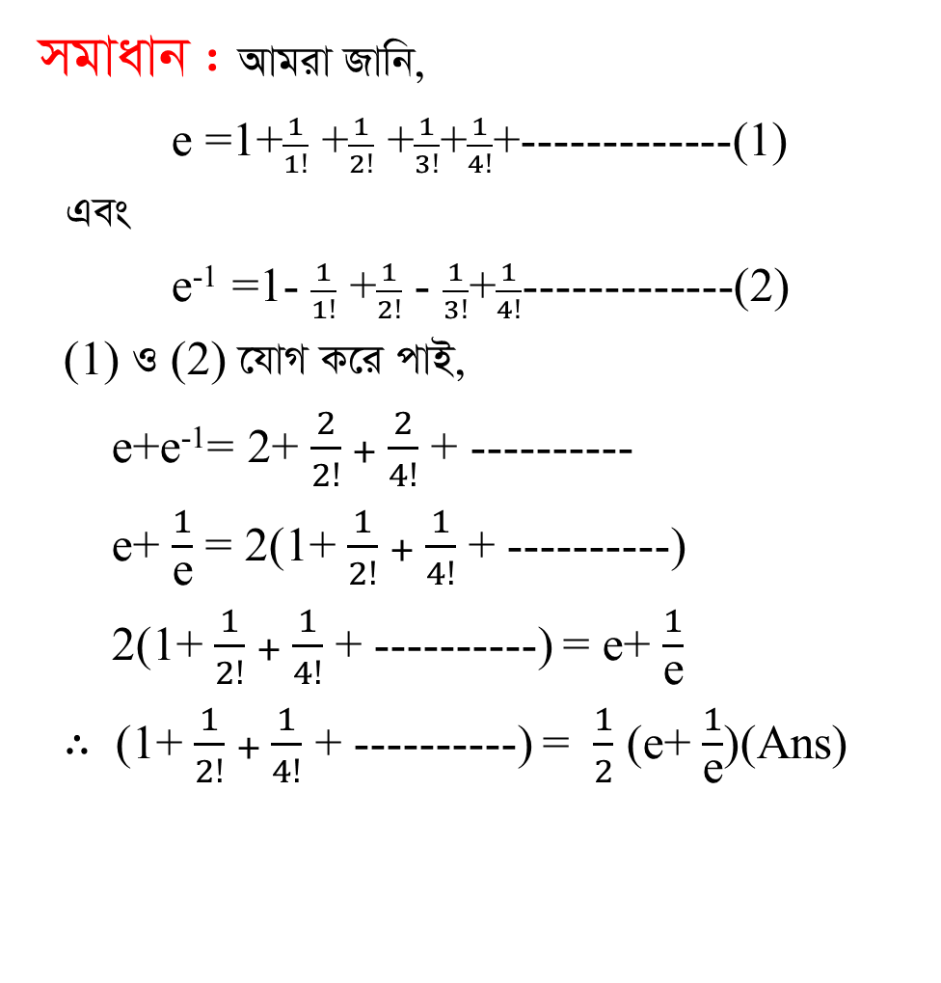

1. 1+$\frac{1}{2!}$ +$\frac{1}{4!}$ +----------- ‡K eGigva¨‡g cÖKvk Ki |
AwZ msw¶ß :
mgvavb :AvgivRvwb,
e =1+$\frac{1}{1!}$ +$\frac{1}{2!}$+$\frac{1}{3!}$+$\frac{1}{4!}$+-------------(1)
Ges
e⁻¹ =1- $\frac{1}{1!}$ +$\frac{1}{2!}$ - $\frac{1}{3!}$+$\frac{1}{4!}$-------------(2)
(1) I (2) ‡hvMK‡icvB,
e+e⁻¹= 2+ $\frac{2}{2!}+\frac{2}{4!}$ + ----------
e+ $\frac{1}{\text{e}}$ = 2(1+ $\frac{1}{2!}+\frac{1}{4!}$ + ----------)
2(1+ $\frac{1}{2!}+\frac{1}{4!}$ + ----------) = e+ $\frac{1}{\text{e}}$
$∴$ (1+ $\frac{1}{2!}+\frac{1}{4!}$ + ----------) = $\frac{1}{2}$ (e+ $\frac{1}{\text{e}}$)(Ans)

Slide 5
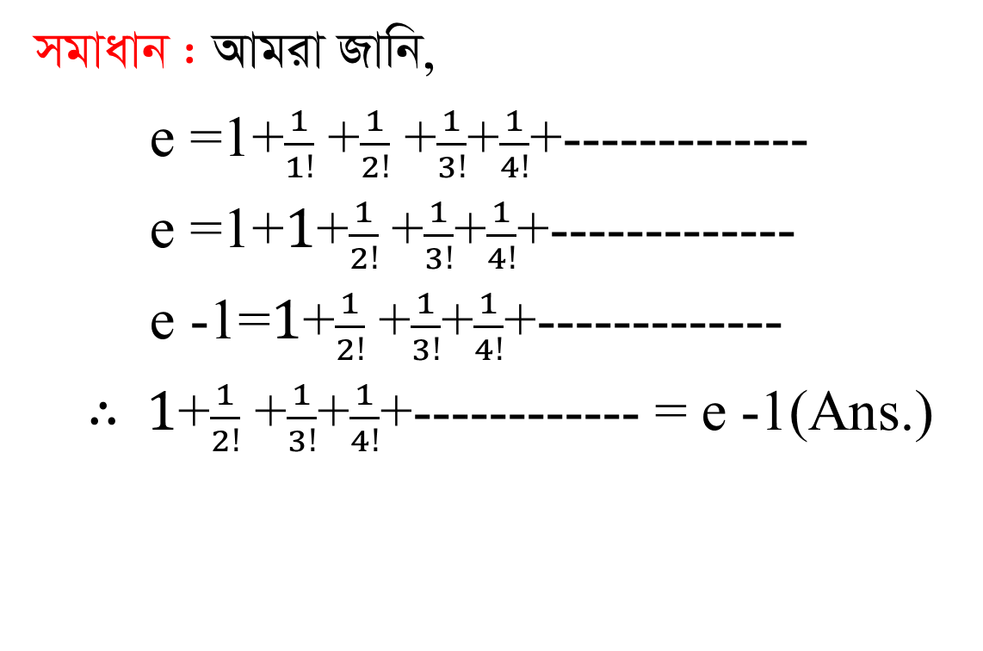

2. 1+ $\frac{1}{2!}$+$\frac{1}{3!}$+$\frac{1}{4!}$+-------------- GigvbwjL|
mgvavb :AvgivRvwb,
e =1+$\frac{1}{1!}$ +$\frac{1}{2!}$+$\frac{1}{3!}$+$\frac{1}{4!}$+-------------
e =1+$1$+$\frac{1}{2!}$+$\frac{1}{3!}$+$\frac{1}{4!}$+-------------
e -1=$1$+$\frac{1}{2!}$+$\frac{1}{3!}$+$\frac{1}{4!}$+-------------
$∴1$+$\frac{1}{2!}$+$\frac{1}{3!}$+$\frac{1}{4!}$+------------ = e -1(Ans.)

Slide 6
3.1+3+5+7+---------avivwUi n Zg c` wbY©q Ki|
mgvavb : 1+3+5+7+---------
GLv‡b, cÖ_g c` a = 1
mvaviY AšÍi d=3-1=2
avivwUi n Zg c` = a+(n-1)d
= 1+(n-1)2
= 1+2n-2
= 2n-1(Ans.)

Slide 7
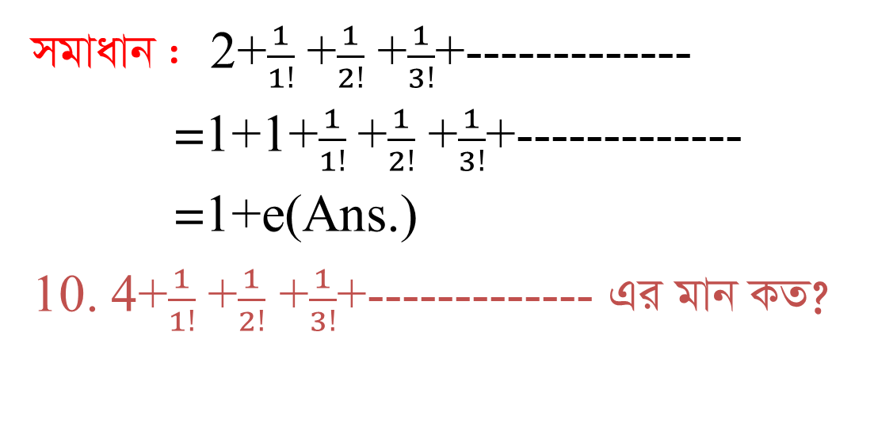
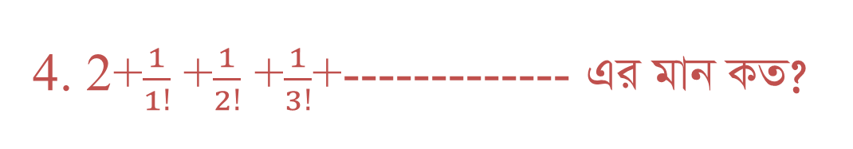
4. 2+$\frac{1}{1!}$ +$\frac{1}{2!}$+$\frac{1}{3!}$+------------- GigvbKZ?
mgvavb : 2+$\frac{1}{1!}$ +$\frac{1}{2!}$+$\frac{1}{3!}$+-------------
=1+1+$\frac{1}{1!}$ +$\frac{1}{2!}$+$\frac{1}{3!}$+-------------
=1+e(Ans.)
10.4+$\frac{1}{1!}$ +$\frac{1}{2!}$ +$\frac{1}{3!}$+------------- Gi gvb KZ?

Slide 8
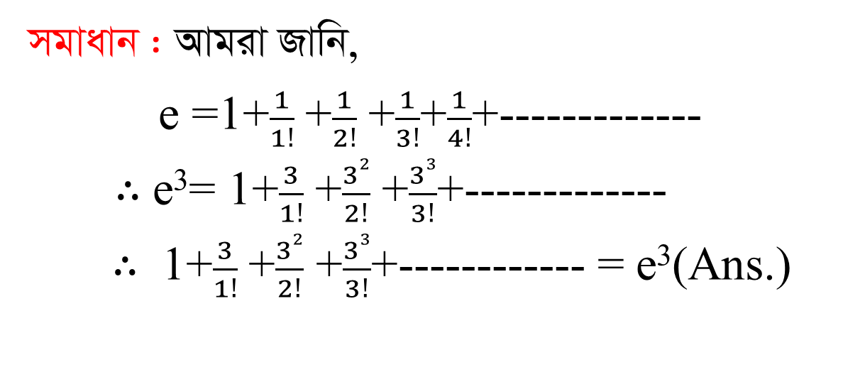

5. 1+$\frac{3}{1!}$ +$\frac{32}{2!}$+$\frac{33}{3!}$+-------------avivwUigvbwjL|
mgvavb : Avgiv Rvwb,
e =1+$\frac{1}{1!}$ +$\frac{1}{2!}$+$\frac{1}{3!}$+$\frac{1}{4!}$+-------------
$∴$ e³= 1+$\frac{3}{1!}$ +$\frac{32}{2!}$ +$\frac{33}{3!}$+-------------
$∴$ 1+$\frac{3}{1!}$ +$\frac{32}{2!}$ +$\frac{33}{3!}$+------------ = e³(Ans.)

Slide 9
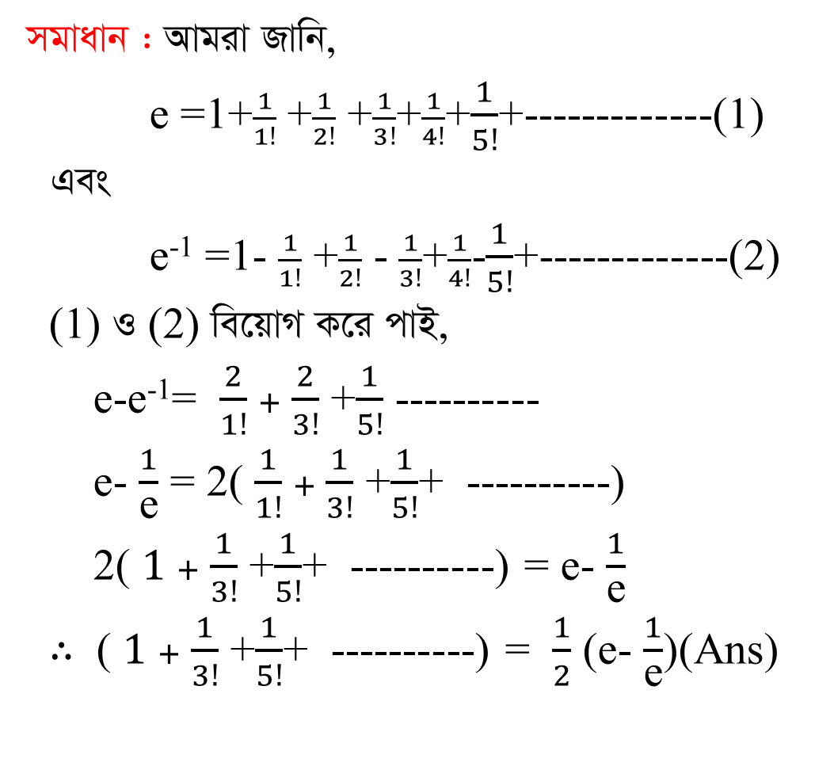

6.1+$\frac{1}{3!}$ +$\frac{1}{5!}$+-------------- Gigvb KZ ?
mgvavb :AvgivRvwb,
e =1+$\frac{1}{1!}$ +$\frac{1}{2!}$+$\frac{1}{3!}$+$\frac{1}{4!}$+$\frac{1}{5!}$+-------------(1)
Ges
e⁻¹ =1- $\frac{1}{1!}$ +$\frac{1}{2!}$ - $\frac{1}{3!}$+$\frac{1}{4!}$-$\frac{1}{5!}$+-------------(2)
(1) I (2) we‡qvMK‡icvB,
e-e⁻¹= $\frac{2}{1!}+\frac{2}{3!}$ +$\frac{1}{5!}$ ----------
e- $\frac{1}{\text{e}}$ = 2( $\frac{1}{1!}+\frac{1}{3!}$ +$\frac{1}{5!}$+ ----------)
2( $1+\frac{1}{3!}$ +$\frac{1}{5!}$+ ----------) = e- $\frac{1}{\text{e}}$
$∴$ ( $1+\frac{1}{3!}$ +$\frac{1}{5!}$+ ----------) = $\frac{1}{2}$ (e- $\frac{1}{\text{e}}$)(Ans)

Slide 10
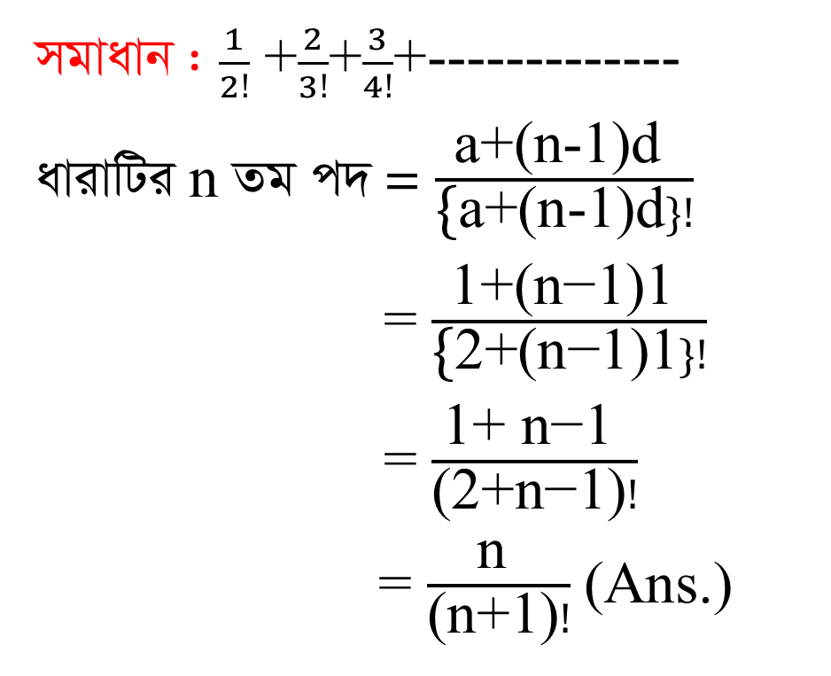
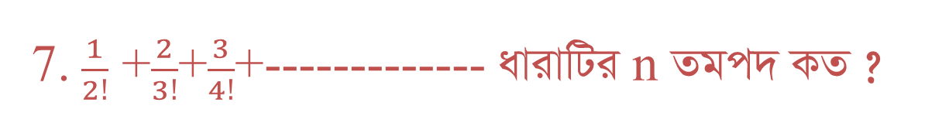
7.$\frac{1}{2!}$+$\frac{2}{3!}$+$\frac{3}{4!}$+-------------avivwUinZgc` KZ ?
mgvavb :$\frac{1}{2!}$+$\frac{2}{3!}$+$\frac{3}{4!}$+-------------
avivwUin Zg c` =$\frac{\text{a}\text{+(}\text{n}\text{−1)}\text{d} }{\text{\{}\text{a}\text{+(}\text{n}\text{−1)}\text{d}\}!}$
= $\frac{\text{1}\text{+(}\text{n}\text{−1)1 }}{\text{\{}\text{2}\text{+(}\text{n}\text{−1)1}\}!}$
= $\frac{\text{1+} \text{n}\text{−1 }}{\text{(2+}\text{n}\text{−1)}!}$
= $\frac{\text{n} }{\text{(}\text{n}\text{+}\text{1)}!}$(Ans.)

Slide 11
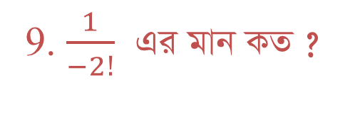



8. -1Gi gvb KZ ?
DËi:$∞$
9. $\frac{1}{−2!}$GigvbKZ ?
DËi:$0$
13. e avivwU wjL |
DËi:e =1+$\frac{1}{1!}$ +$\frac{1}{2!}$ +$\frac{1}{3!}$+$\frac{1}{4!}$+-----------$∞$

Slide 12

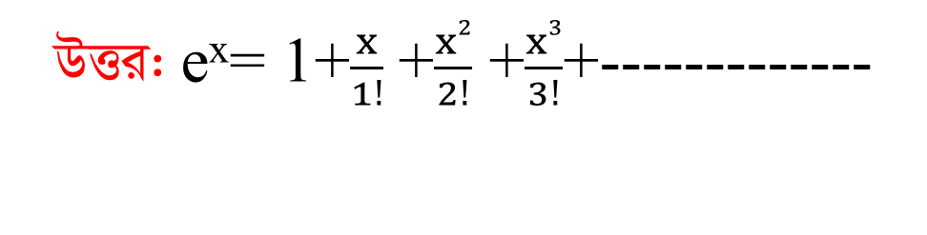

14. e^{x} avivwU wjL |
DËi: e^{x}= 1+$\frac{x}{1!}$ +$\frac{x2}{2!}$ +$\frac{x3}{3!}$+-------------
15. a^{x} avivwU wjL |
DËi:a^{x}= 1+$\frac{x}{1!}$log_{e}a+$\frac{x2}{2!}$(log_{e}a)²+$\frac{x3}{3!}($log_{e}a)³+-----------
16. e^{-x} avivwU wjL |
DËi:e^{-x}=1- $\frac{x}{1!}$ +$\frac{x2}{2!}$ - $\frac{x3}{3!}$+$\frac{x4}{4!}$-------------

Slide 13
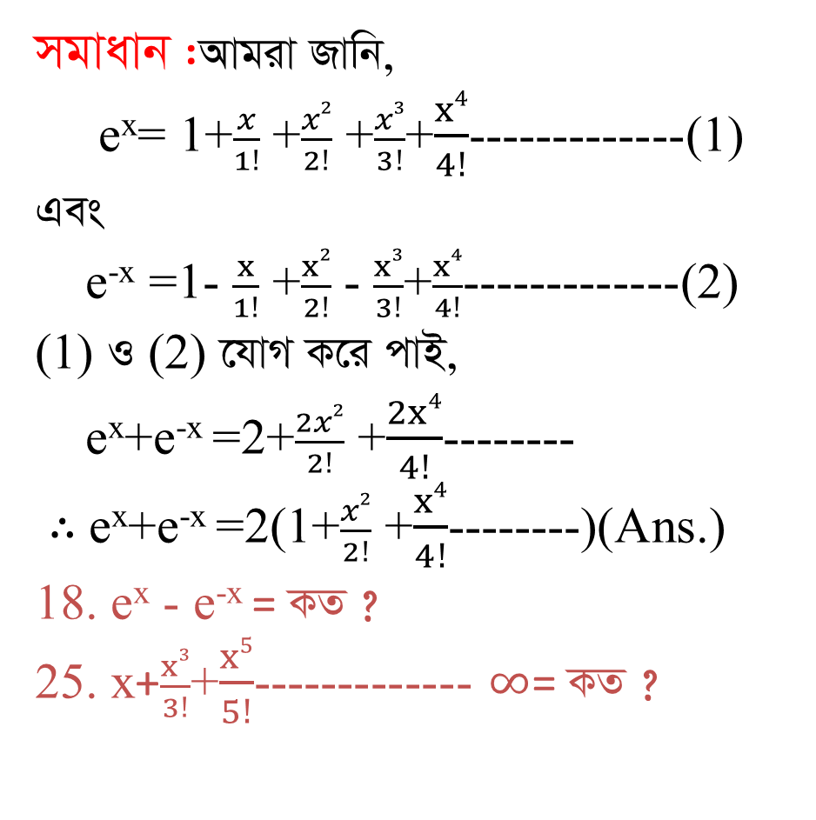
17. e^{x} +e^{-x} = KZ ?
mgvavb:AvgivRvwb,
e^{x}= 1+$\frac{x}{1!}$ +$\frac{x2}{2!}$ +$\frac{x3}{3!}$+$\frac{x4}{4!}$-------------(1)
Ges
e^{-x}=1- $\frac{x}{1!}$ +$\frac{x2}{2!}$ - $\frac{x3}{3!}$+$\frac{x4}{4!}$-------------(2)
(1) I (2) ‡hvMK‡icvB,
e^{x}+e^{-x}=2+$\frac{2x2}{2!}$ +$\frac{2x4}{4!}$--------
$∴$e^{x}+e^{-x}=2(1+$\frac{x2}{2!}$ +$\frac{x4}{4!}$--------)(Ans.)
18. e^{x}- e^{-x} = KZ ?
25. x+$\frac{x3}{3!}$+$\frac{x5}{5!}$-------------$∞$= KZ ?

Slide 14
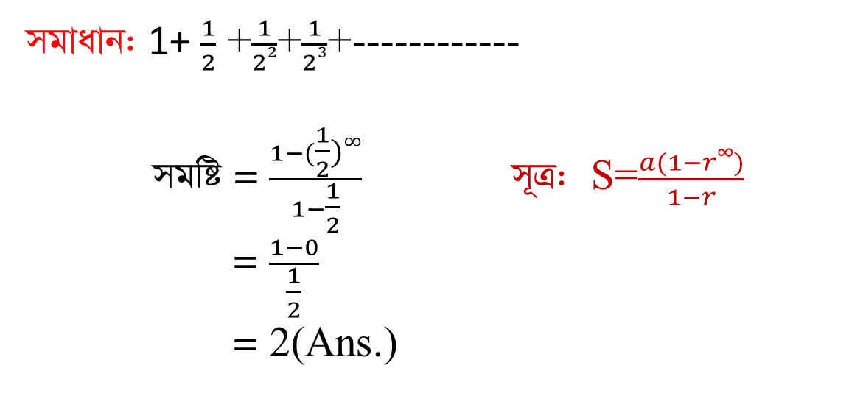

21. e Gi gv‡bi mxgv wjL |
DËi: 2< e <3
22. 1+ $\frac{1}{2}$ +$\frac{1}{22}$+$\frac{1}{23}$+------------Gigvb KZ ?
mgvavb: 1+ $\frac{1}{2}$ +$\frac{1}{22}$+$\frac{1}{23}$+------------
mgwó = $\frac{1−(\frac{1}{2})∞}{1−\frac{1}{2}}$m~Î: S=$\frac{a(1−r∞)}{1−r}$
= $\frac{1−0}{\frac{1}{2}}$
= 2(Ans.)

Slide 15
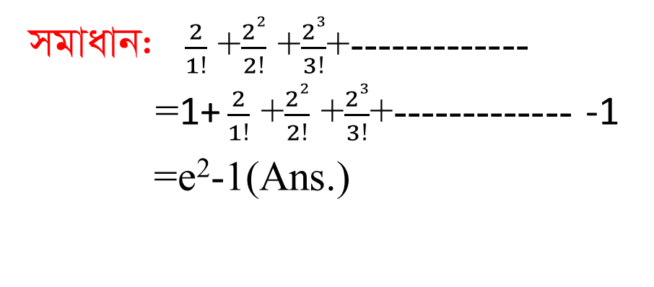
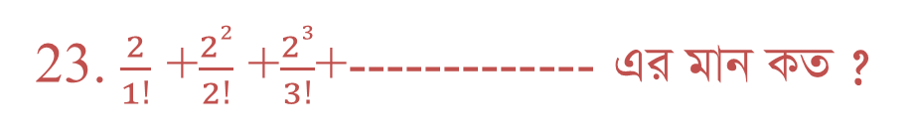

23.$\frac{2}{1!}$ +$\frac{22}{2!}$ +$\frac{23}{3!}$+-------------Gi gvb KZ ?
mgvavb:$\frac{2}{1!}$ +$\frac{22}{2!}$ +$\frac{23}{3!}$+-------------
=1+$\frac{2}{1!}$ +$\frac{22}{2!}$ +$\frac{23}{3!}$+--------------1
=e²-1(Ans.)
24. e⁻¹ Gi gvb KZ ?
DËi:e⁻¹=1- $\frac{1}{1!}$ +$\frac{1}{2!}$ - $\frac{1}{3!}$+$\frac{1}{4!}$-------------

Slide 16
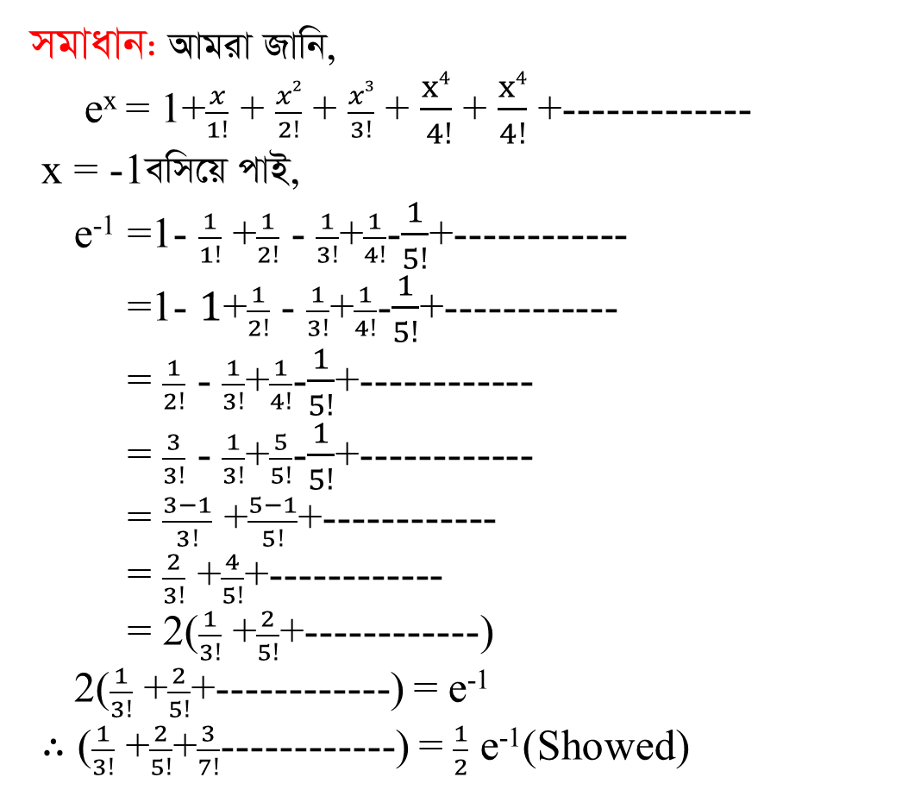
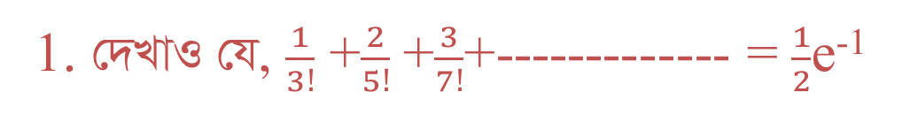
msw¶ß :
1.†`LvI †h, $\frac{1}{3!}$ +$\frac{2}{5!}$ +$\frac{3}{7!}$+-------------= $\frac{1}{2}$e⁻¹
mgvavb:Avgiv Rvwb,
e^{x} = 1+$\frac{x}{1!}$ +$\frac{x2}{2!}$ +$\frac{x3}{3!}$+$\frac{x4}{ 4!}$ + $\frac{x4}{4!}$ +-------------
x = -1ewm‡q cvB,
e⁻¹=1- $\frac{1}{1!}$ +$\frac{1}{2!}$ - $\frac{1}{3!}$+$\frac{1}{4!}$-$\frac{1}{5!}$+------------
=1- $1$+$\frac{1}{2!}$ - $\frac{1}{3!}$+$\frac{1}{4!}$-$\frac{1}{5!}$+------------
= $\frac{1}{2!}$ - $\frac{1}{3!}$+$\frac{1}{4!}$-$\frac{1}{5!}$+------------
= $\frac{3}{3!}$ - $\frac{1}{3!}$+$\frac{5}{5!}$-$\frac{1}{5!}$+------------
= $\frac{3−1}{3!}$ +$\frac{5−1}{5!}$+------------
=$\frac{2}{3!}$ +$\frac{4}{5!}$+------------
= 2($\frac{1}{3!}$ +$\frac{2}{5!}$+------------)
2($\frac{1}{3!}$ +$\frac{2}{5!}$+------------) = e⁻¹
$∴$($\frac{1}{3!}$ +$\frac{2}{5!}$+$\frac{3}{7!}$------------) = $\frac{1}{2}$e⁻¹(Showed)

Slide 17

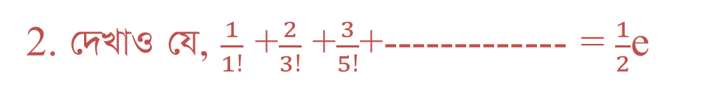
2. †`LvI †h, $\frac{1}{1!}$ +$\frac{2}{3!}$ +$\frac{3}{5!}$+-------------= $\frac{1}{2}$e
mgvavb: Avgiv Rvwb,
e^{x} = 1+$\frac{x}{1!}$ + $\frac{x2}{2!}$ + $\frac{x3}{3!}$ + $\frac{x4}{ 4!}$ + $\frac{x4}{4!}$ +-------------
x = 1ewm‡q cvB,
e¹ = 1+ $\frac{1}{1!}$ +$\frac{1}{2!}$+ $\frac{1}{3!}$+$\frac{1}{4!}$+$\frac{1}{5!}$+------------
= 1+$1$+$\frac{1}{2!}$+ $\frac{1}{3!}$+$\frac{1}{4!}$+$\frac{1}{5!}$+------------
= 2+$\frac{1}{2!}$+$\frac{1}{3!}$+$\frac{1}{4!}$+$\frac{1}{5!}$+------------
= 2+$\frac{3}{3!}$+ $\frac{1}{3!}$+$\frac{5}{5!}$+$\frac{1}{5!}$+------------
= 2+ $\frac{3+1}{3!}$ +$\frac{5+1}{5!}$+------------
= 2+ $\frac{4}{3!}$ +$\frac{6}{5!}$+------------
= 2(1+$\frac{2}{3!}$ +$\frac{3}{5!}$+------------)
= 2($\frac{1}{1!}$+$\frac{2}{3!}$ +$\frac{3}{5!}$+------------)
2($\frac{1}{1!}$+$\frac{2}{3!}$ +$\frac{3}{5!}$+------------) = e
$∴$($\frac{1}{1!}$+$\frac{2}{3!}$ +$\frac{3}{5!}$+------------) = $\frac{1}{2}$e(Showed)

Slide 18
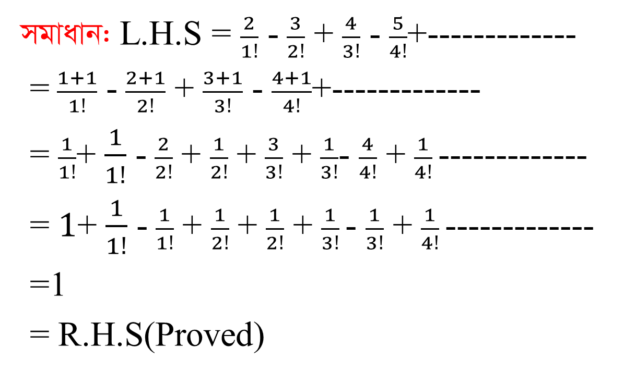
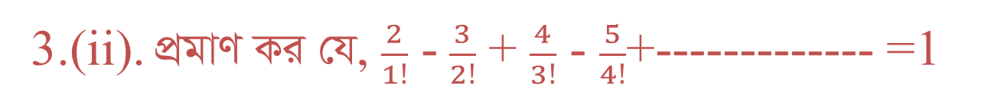
3.(ii).cÖgvY Ki †h,$\frac{2}{1!}$-$\frac{3}{2!}$+ $\frac{4}{3!}$ - $\frac{5}{4!}$+-------------=1
mgvavb:L.H.S =$\frac{2}{1!}$ -$\frac{3}{2!}$ + $\frac{4}{3!}$ - $\frac{5}{4!}$+-------------
=$\frac{1+1}{1!}$ -$\frac{2+1}{2!}$ + $\frac{3+1}{3!}$ - $\frac{4+1}{4!}$+-------------
=$\frac{1}{1!}$+ $\frac{1}{1!}$ -$\frac{2}{2!}$ + $\frac{1}{2!}$ + $\frac{3}{3!}$+ $\frac{1}{3!}$- $\frac{4}{4!}$+$\frac{1}{4!}$-------------
= $1$+ $\frac{1}{1!}$ -$\frac{1}{1!}$ + $\frac{1}{2!}$ + $\frac{1}{2!}$ + $\frac{1}{3!}$- $\frac{1}{3!}$ + $\frac{1}{4!}$-------------
=1
= R.H.S(Proved)

Slide 19
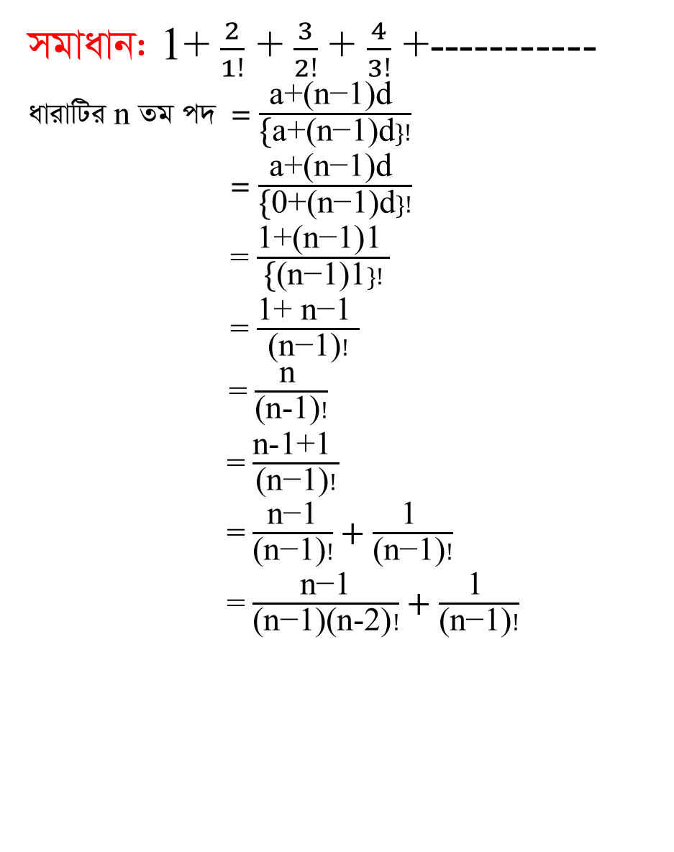
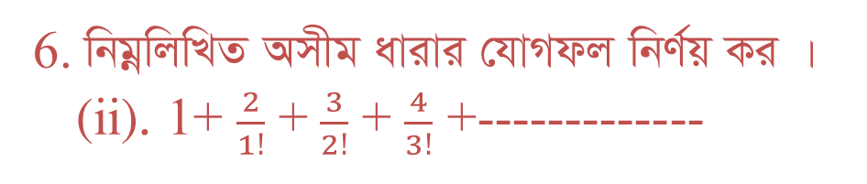
6.wbgœwjwLZAmxgavivi †hvMdjwbY©q Ki |
(ii).1+ $\frac{2}{1!}$+$\frac{3}{2!}$ + $\frac{4}{3!}$ +-------------
mgvavb: 1+ $\frac{2}{1!}$ +$\frac{3}{2!}$ + $\frac{4}{3!}$+-----------
avivwUin Zg c` =$\frac{\text{a}\text{+(}\text{n}\text{−1)}\text{d} }{\text{\{}\text{a}\text{+(}\text{n}\text{−1)}\text{d}\}!}$
=$\frac{\text{a}\text{+(}\text{n}\text{−1)}\text{d} }{\text{\{}\text{0}\text{+(}\text{n}\text{−1)}\text{d}\}!}$
= $\frac{\text{1+(}\text{n}\text{−1)1 }}{\text{\{}\text{(}\text{n}\text{−1)1}\}!}$
= $\frac{\text{1+ }\text{n}\text{−1 }}{\text{(}\text{n}\text{−1)}!}$
= $\frac{\text{n} }{\text{(}\text{n}\text{−}\text{1)}!}$
=$\frac{\text{n}\text{−1+1} }{\text{(}\text{n}\text{−1)}!}$
= $\frac{\text{n}\text{−1}}{\text{(}\text{n}\text{−1)}!}+\frac{\text{1 }}{\text{(}\text{n}\text{−1)}!}$
= $\frac{\text{n}\text{−1}}{\text{(}\text{n}\text{−1)(}\text{n}\text{−2)}!}+\frac{\text{1 }}{\text{(}\text{n}\text{−1)}!}$

Slide 20
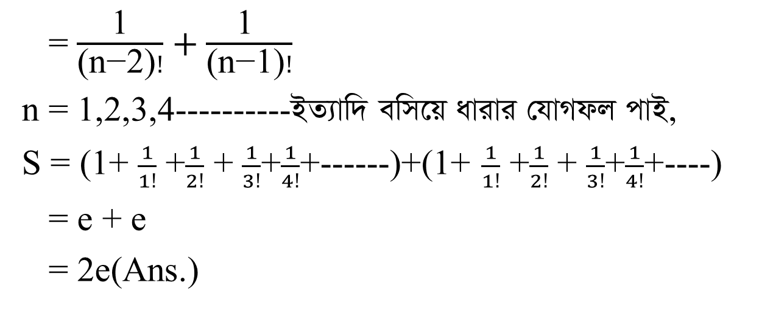
= $\frac{\text{1}}{\text{(}\text{n}\text{−2)}!}+\frac{\text{1 }}{\text{(}\text{n}\text{−1)}!}$
n = 1,2,3,4----------BZ¨vw` ewm‡qavivi†hvMdjcvB,
S = (1+ $\frac{1}{1!}$ +$\frac{1}{2!}$ + $\frac{1}{3!}$+$\frac{1}{4!}$+------)+(1+ $\frac{1}{1!}$ +$\frac{1}{2!}$ + $\frac{1}{3!}$+$\frac{1}{4!}$+----)
= e + e
= 2e(Ans.)

Slide 21
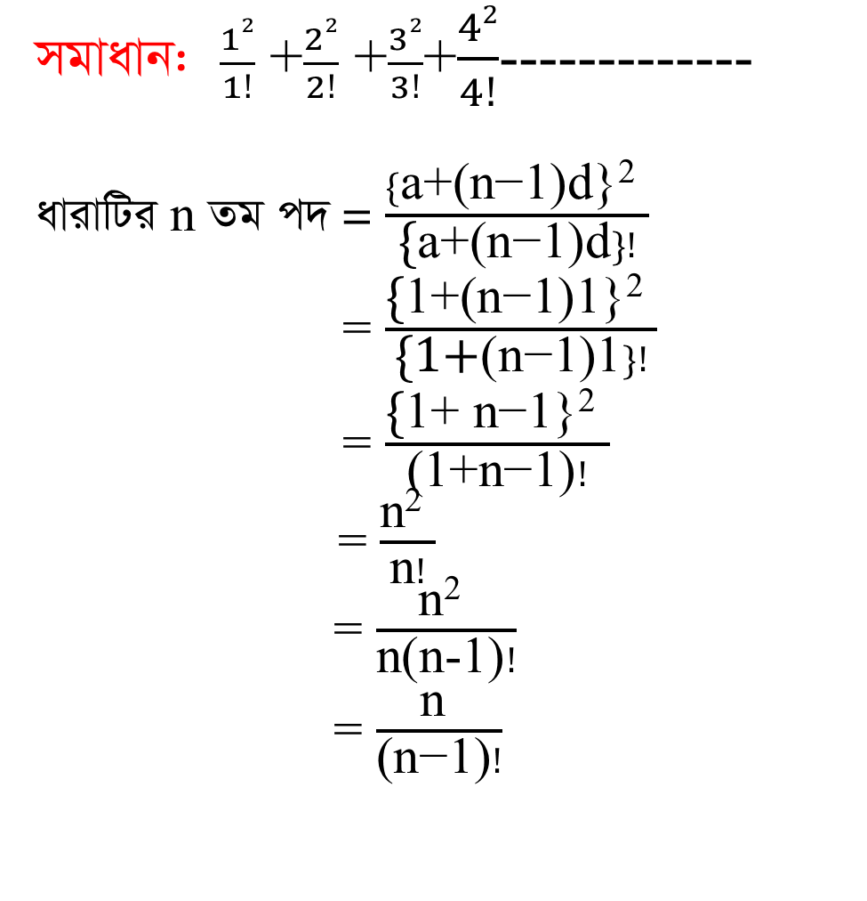
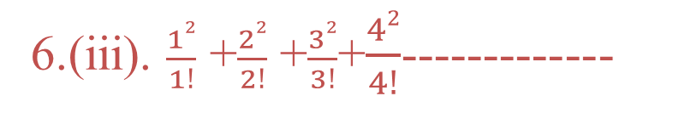
6.(iii).$\frac{12}{1!}$ +$\frac{22}{2!}$ +$\frac{32}{3!}$+$\frac{42}{4!}$-------------
mgvavb:$\frac{12}{1!}$ +$\frac{22}{2!}$ +$\frac{32}{3!}$+$\frac{42}{4!}$-------------
avivwUin Zg c` = $\frac{\{\text{a}\text{+(}\text{n}\text{−1)}\text{d}\text{\}}\text{2} }{\text{\{}\text{a}\text{+(}\text{n}\text{−1)}\text{d}\}!}$
= $\frac{\text{\{}\text{1+(}\text{n}\text{−1)1\}2 }}{\text{\{}\text{1+}\text{(}\text{n}\text{−1)1}\}!}$
= $\frac{\text{\{}\text{1+ }\text{n}\text{−1\}2 }}{\text{(}\text{1}\text{+}\text{n}\text{−1)}!}$
= $\frac{\text{n}\text{2} }{\text{n}!}$
= $\frac{\text{n}\text{2} }{\text{n}\text{(}\text{n}\text{−1)}!}$
=$\frac{\text{n} }{\text{(}\text{n}\text{−1)}!}$

Slide 22
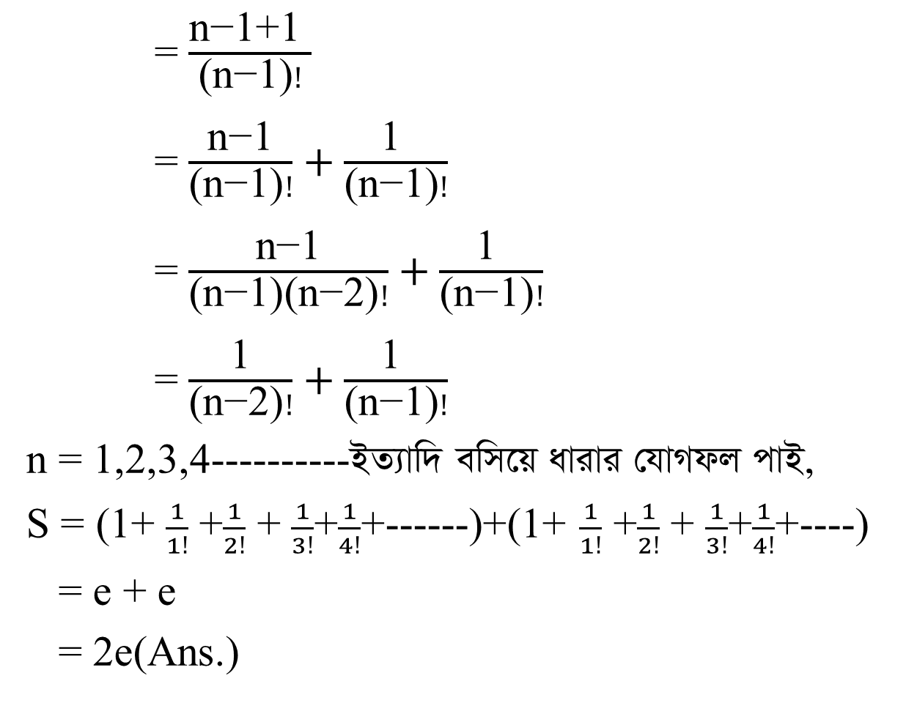
= $\frac{\text{n}\text{−1+1 }}{\text{(}\text{n}\text{−1)}!}$
= $\frac{\text{n}\text{−1}}{\text{(}\text{n}\text{−1)}!}+\frac{\text{1 }}{\text{(}\text{n}\text{−1)}!}$
= $\frac{\text{n}\text{−1}}{\text{(}\text{n}\text{−1)(}\text{n}\text{−2)}!}+\frac{\text{1 }}{\text{(}\text{n}\text{−1)}!}$
= $\frac{\text{1}}{\text{(}\text{n}\text{−2)}!}+\frac{\text{1 }}{\text{(}\text{n}\text{−1)}!}$
n = 1,2,3,4----------BZ¨vw` ewm‡qavivi †hvMdjcvB,
S = (1+ $\frac{1}{1!}$ +$\frac{1}{2!}$ + $\frac{1}{3!}$+$\frac{1}{4!}$+------)+(1+ $\frac{1}{1!}$ +$\frac{1}{2!}$ + $\frac{1}{3!}$+$\frac{1}{4!}$+----)
= e + e
= 2e(Ans.)

Slide 23
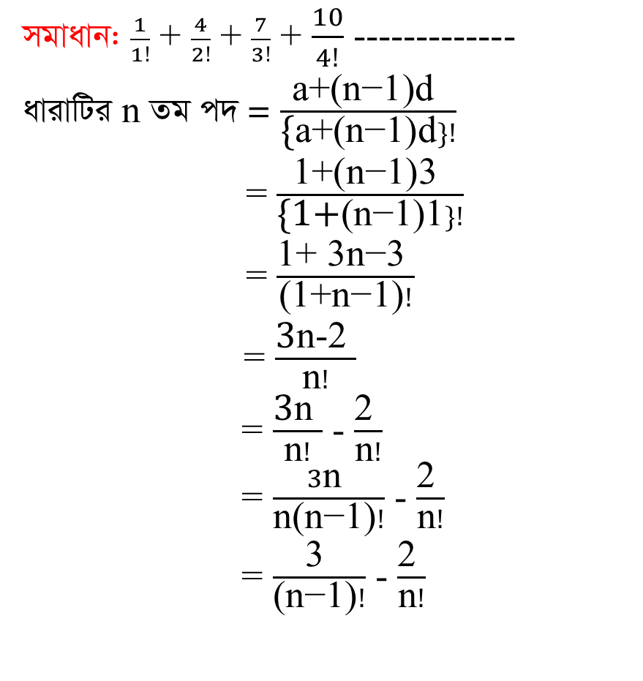

6.(v).$\frac{1}{1!}$ +$\frac{4}{2!}$ +$\frac{7}{3!}$+$\frac{10}{4!}$-------------
mgvavb:$\frac{1}{1!}$ + $\frac{4}{2!}$ + $\frac{7}{3!}$ + $\frac{10}{4!}$ -------------
avivwUi n Zg c` = $\frac{\text{a}\text{+(}\text{n}\text{−1)}\text{d} }{\text{\{}\text{a}\text{+(}\text{n}\text{−1)}\text{d}\}!}$
= $\frac{\text{1+(}\text{n}\text{−1)3 }}{\text{\{1+}\text{(}\text{n}\text{−1)1}\}!}$
= $\frac{\text{1+ }\text{3}\text{n}\text{−3 }}{\text{(1+}\text{n}\text{−1)}!}$
= $\frac{\text{3}\text{n}\text{−2} }{\text{n}!}$
= $\frac{\text{3}\text{n} }{\text{n}!}$ - $\frac{\text{2 }}{\text{n}!}$
= $\frac{3\text{n} }{\text{n}\text{(}\text{n}\text{−1)}!}$- $\frac{\text{2 }}{\text{n}!}$
= $\frac{\text{3} }{\text{(}\text{n}\text{−1)}!}$- $\frac{\text{2 }}{\text{n}!}$

Slide 24
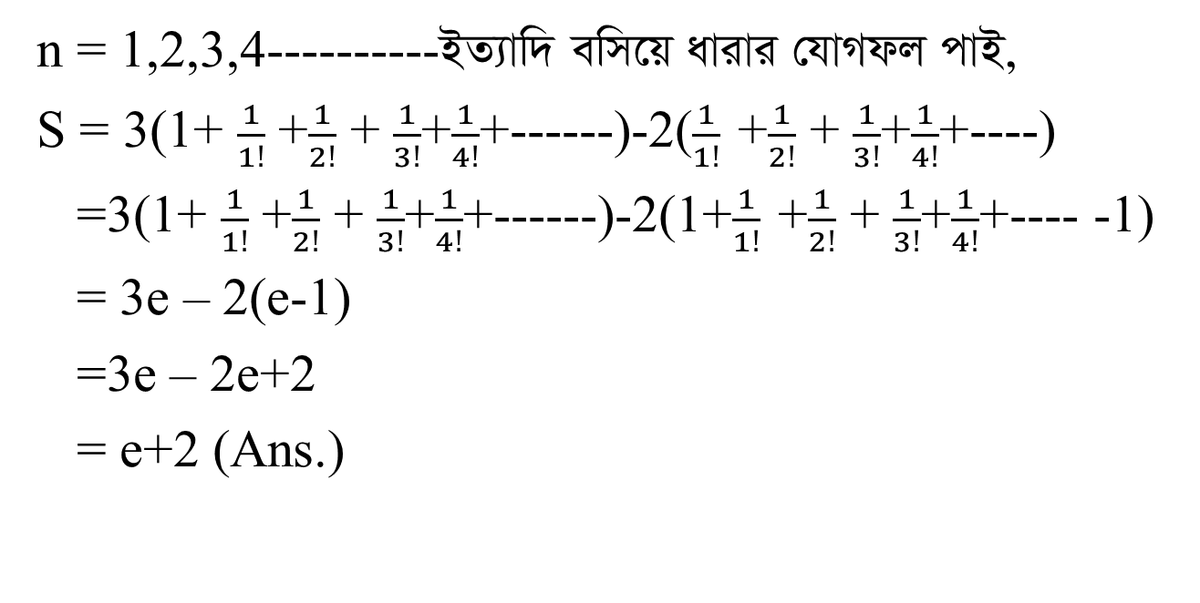
n = 1,2,3,4----------BZ¨vw` ewm‡qavivi †hvMdjcvB,
S = 3(1+ $\frac{1}{1!}$ +$\frac{1}{2!}$ + $\frac{1}{3!}$+$\frac{1}{4!}$+------)-2($\frac{1}{1!}$ +$\frac{1}{2!}$ + $\frac{1}{3!}$+$\frac{1}{4!}$+----)
=3(1+ $\frac{1}{1!}$ +$\frac{1}{2!}$ + $\frac{1}{3!}$+$\frac{1}{4!}$+------)-2(1+$\frac{1}{1!}$ +$\frac{1}{2!}$ + $\frac{1}{3!}$+$\frac{1}{4!}$+---- -1)
= 3e – 2(e-1)
=3e – 2e+2
= e+2 (Ans.)

Slide 25
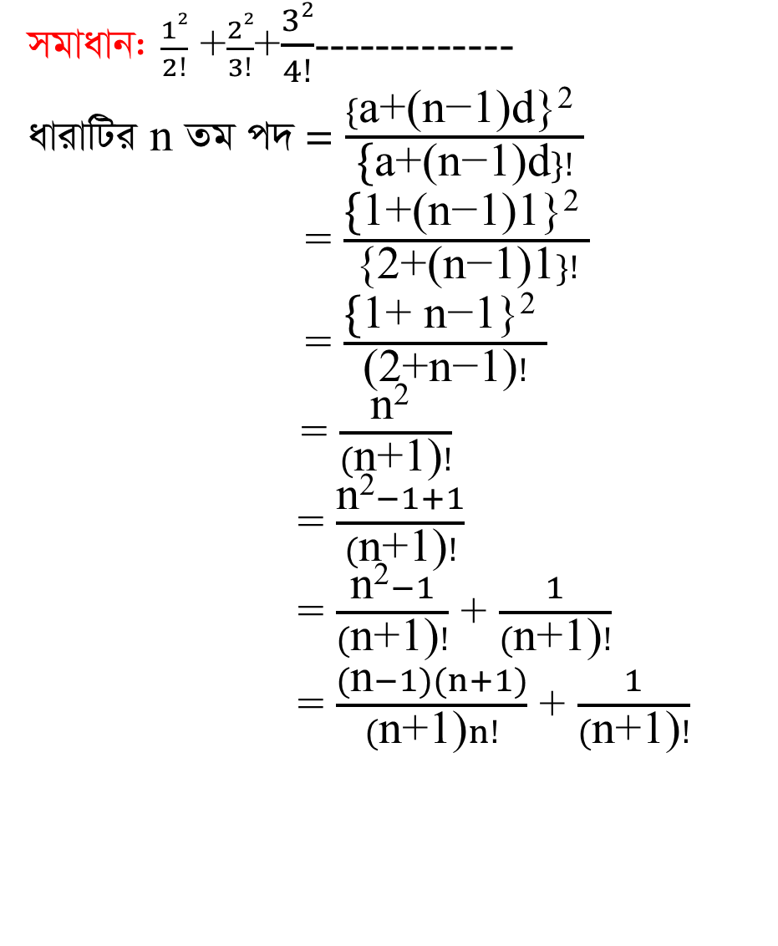
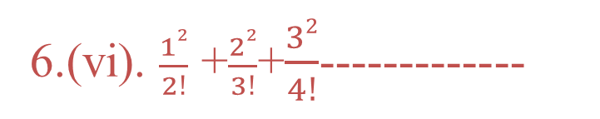
6.(vi).$\frac{12}{2!}$ +$\frac{22}{3!}$+$\frac{32}{4!}$-------------
mgvavb: $\frac{12}{2!}$ +$\frac{22}{3!}$+$\frac{32}{4!}$-------------
avivwUi n Zg c` = $\frac{\{\text{a}\text{+(}\text{n}\text{−1)}\text{d}\text{\}}\text{2} }{\text{\{}\text{a}\text{+(}\text{n}\text{−1)}\text{d}\}!}$
= $\frac{\text{\{}\text{1+(}\text{n}\text{−1)1\}2 }}{\text{\{}\text{2}\text{+(}\text{n}\text{−1)1}\}!}$
= $\frac{\text{\{}\text{1+ }\text{n}\text{−1\}2 }}{\text{(}\text{2}\text{+}\text{n}\text{−1)}!}$
= $\frac{\text{n}\text{2} }{(\text{n}\text{+1)}!}$
= $\frac{\text{n}\text{2}−1+1}{(\text{n}\text{+1)}!}$
= $\frac{\text{n}\text{2}−1}{(\text{n}\text{+1)}!}$ + $\frac{1}{(\text{n}\text{+1)}!}$
=$\frac{(\text{n}−1)(n+1)}{(\text{n}\text{+1)}n!}$ + $\frac{1}{(\text{n}\text{+1)}!}$

Slide 26
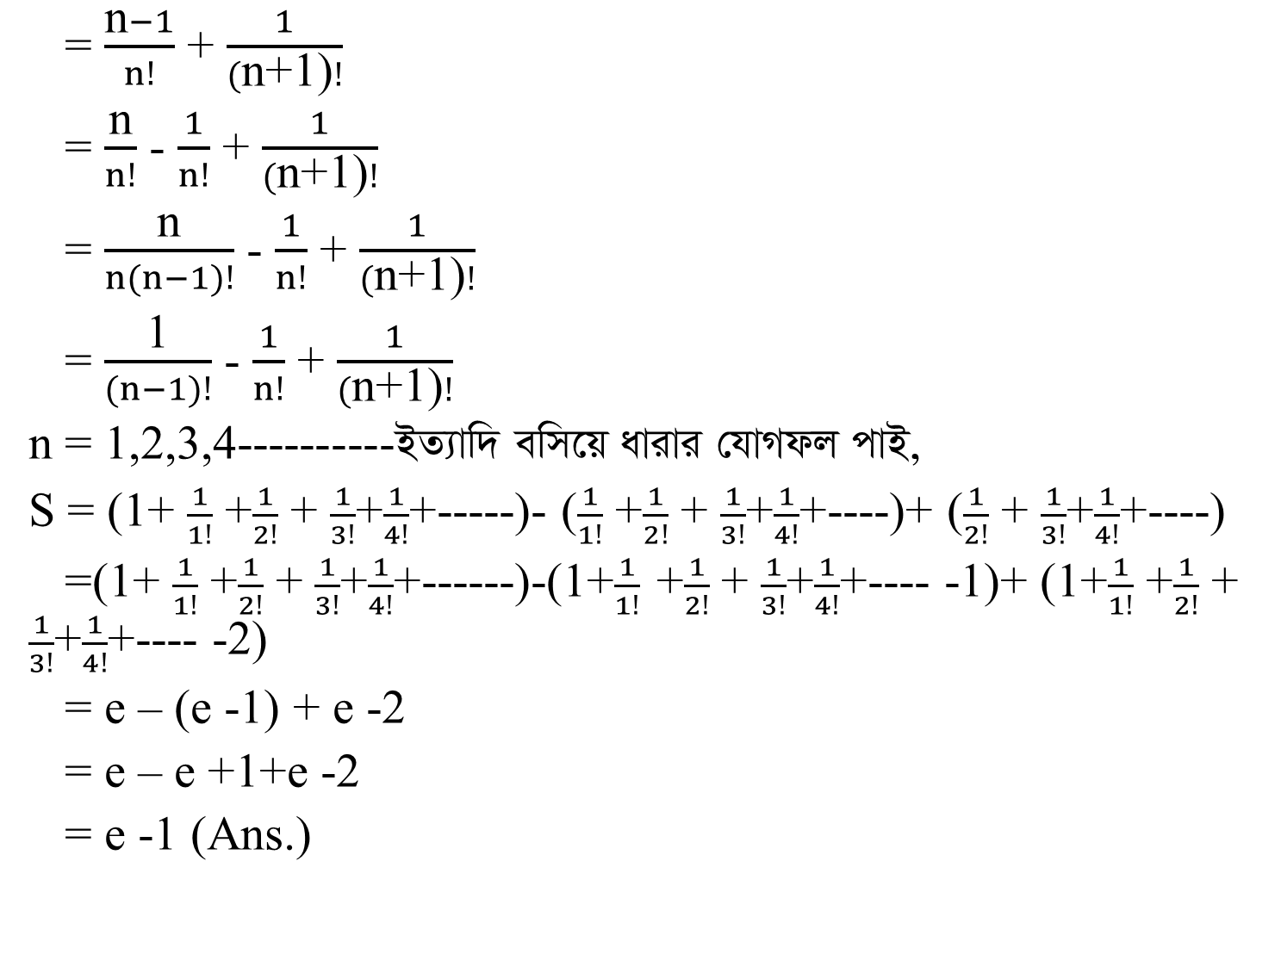
= $\frac{\text{n}−1}{n!}$ + $\frac{1}{(\text{n}\text{+1)}!}$
= $\frac{\text{n}}{n!}$ -$\frac{1}{n!}$+ $\frac{1}{(\text{n}\text{+1)}!}$
= $\frac{\text{n}}{n(n−1)!}$ - $\frac{1}{n!}$ + $\frac{1}{(\text{n}\text{+1)}!}$
= $\frac{\text{1}}{(n−1)!}$ - $\frac{1}{n!}$ + $\frac{1}{(\text{n}\text{+1)}!}$
n = 1,2,3,4----------BZ¨vw` ewm‡qavivi †hvMdjcvB,
S = (1+ $\frac{1}{1!}$ +$\frac{1}{2!}$ + $\frac{1}{3!}$+$\frac{1}{4!}$+-----)-($\frac{1}{1!}$ +$\frac{1}{2!}$ + $\frac{1}{3!}$+$\frac{1}{4!}$+----)+ ($\frac{1}{2!}$ + $\frac{1}{3!}$+$\frac{1}{4!}$+----)
=(1+ $\frac{1}{1!}$ +$\frac{1}{2!}$ + $\frac{1}{3!}$+$\frac{1}{4!}$+------)-(1+$\frac{1}{1!}$ +$\frac{1}{2!}$ + $\frac{1}{3!}$+$\frac{1}{4!}$+---- -1)+ (1+$\frac{1}{1!}$+$\frac{1}{2!}$ + $\frac{1}{3!}$+$\frac{1}{4!}$+---- -2)
= e – (e -1) + e -2
= e – e +1+e -2
= e -1 (Ans.)

Slide 27
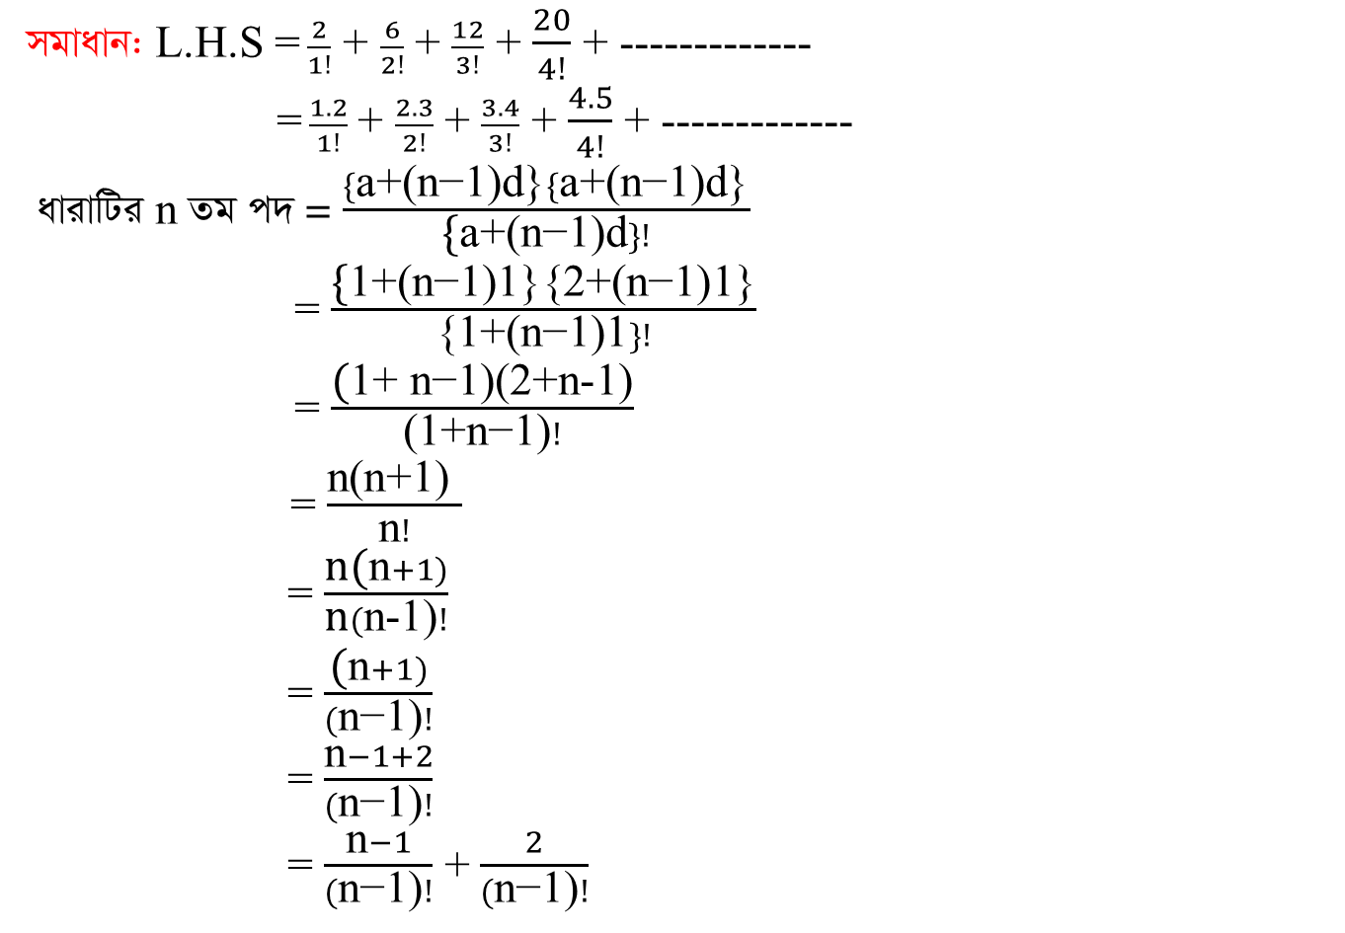
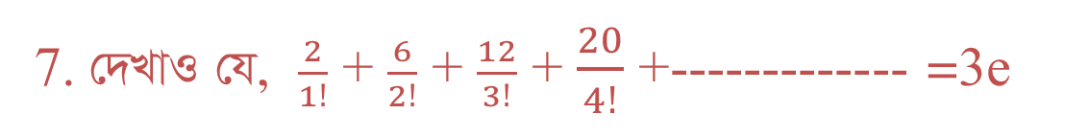
7.†`LvI †h, $\frac{2}{1!}$ + $\frac{6}{2!}$ + $\frac{12}{3!}$ + $\frac{20}{4!}$+-------------=3e
mgvavb: L.H.S =$\frac{2}{1!}$ + $\frac{6}{2!}$ + $\frac{12}{3!}$ + $\frac{20}{4!}$ + -------------
=$\frac{1.2}{1!}$ + $\frac{2.3}{2!}$ + $\frac{3.4}{3!}$ + $\frac{4.5}{4!}$ +-------------
avivwUi n Zg c` = $\frac{\{\text{a}\text{+(}\text{n}\text{−1)}\text{d}\text{\}}\{\text{a}\text{+(}\text{n}\text{−1)}\text{d}\text{\}}}{\text{\{}\text{a}\text{+(}\text{n}\text{−1)}\text{d}\}!}$
= $\frac{\text{\{}\text{1+(}\text{n}\text{−1)1\}\{2+(}\text{n}\text{−1)1\}}}{\text{\{}\text{1}\text{+(}\text{n}\text{−1)1}\}!}$
= $\frac{\text{(}\text{1+ }\text{n}\text{−1)(2+}\text{n}\text{−1)}}{\text{(}\text{1}\text{+}\text{n}\text{−1)}!}$
= $\frac{\text{n}\text{(}\text{n}\text{+1) }}{\text{n}!}$
= $\frac{\text{n}\text{(}\text{n}+1)}{\text{n}(\text{n}\text{−}\text{1)}!}$
=$\frac{\text{(}\text{n}+1)}{(\text{n}\text{−1)}!}$
= $\frac{\text{n}−1+2}{(\text{n}\text{−1)}!}$
= $\frac{\text{n}−1}{(\text{n}\text{−1)}!}$ + $\frac{2}{(\text{n}\text{−1)}!}$

Slide 28
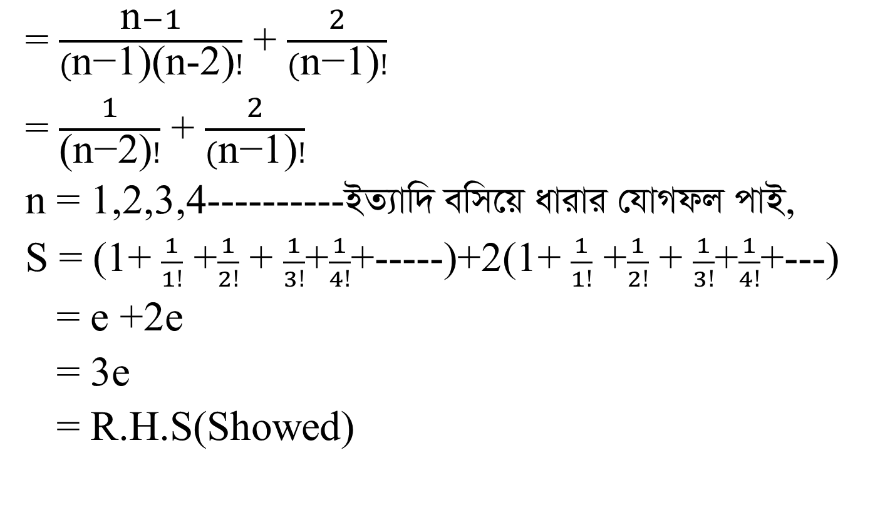
= $\frac{\text{n}−1}{(\text{n}\text{−1)(}\text{n}\text{−2)}!}$ + $\frac{2}{(\text{n}\text{−1)}!}$
=$\frac{1}{\text{(}\text{n}\text{−2)}!}$ + $\frac{2}{(\text{n}\text{−1)}!}$
n = 1,2,3,4----------BZ¨vw` ewm‡qavivi †hvMdjcvB,
S = (1+ $\frac{1}{1!}$ +$\frac{1}{2!}$ + $\frac{1}{3!}$+$\frac{1}{4!}$+-----)+2(1+ $\frac{1}{1!}$ +$\frac{1}{2!}$ + $\frac{1}{3!}$+$\frac{1}{4!}$+---)
= e +2e
= 3e
= R.H.S(Showed)

Slide 29
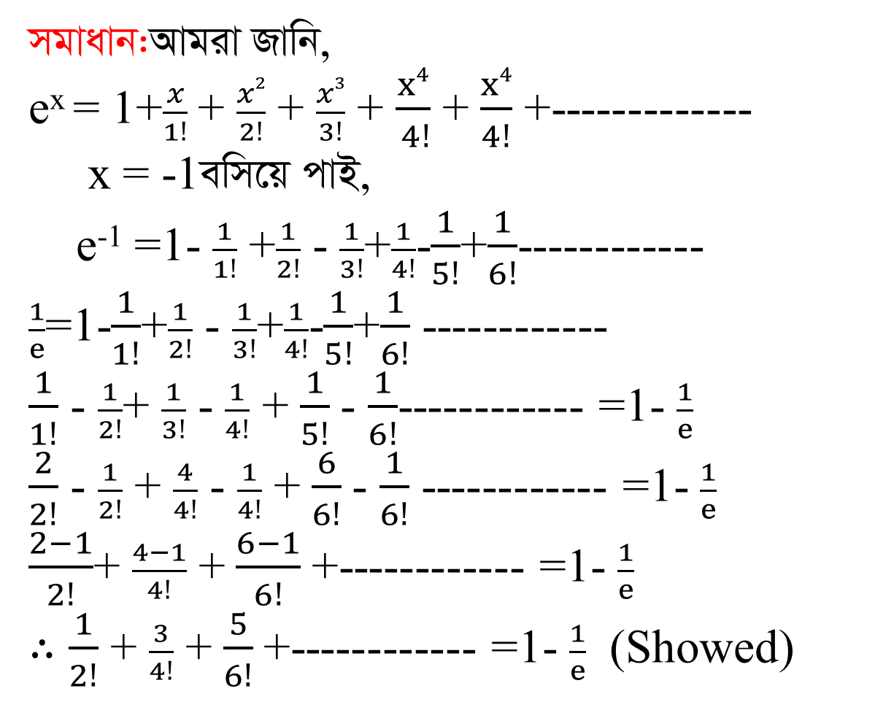
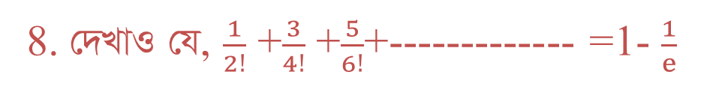
8.†`LvI †h, $\frac{1}{2!}$ +$\frac{3}{4!}$ +$\frac{5}{6!}$+-------------=1- $\frac{1}{e}$
mgvavb:Avgiv Rvwb,
e^{x} = 1+$\frac{x}{1!}$ + $\frac{x2}{2!}$ + $\frac{x3}{3!}$ + $\frac{x4}{ 4!}$ + $\frac{x4}{4!}$ +-------------
x = -1ewm‡q cvB,
e⁻¹ =1- $\frac{1}{1!}$ +$\frac{1}{2!}$ - $\frac{1}{3!}$+$\frac{1}{4!}$-$\frac{1}{5!}$+$\frac{1}{6!}$------------
$\frac{1}{e}$=1-$\frac{1}{1!}$+$\frac{1}{2!}$ - $\frac{1}{3!}$+$\frac{1}{4!}$-$\frac{1}{5!}$+$\frac{1}{6!}$ ------------
$\frac{1}{1!}$ - $\frac{1}{2!}$+ $\frac{1}{3!}$ - $\frac{1}{4!}$ +$\frac{1}{5!}$ - $\frac{1}{6!}$------------ =1- $\frac{1}{e}$
$\frac{2}{2!}$ - $\frac{1}{2!}$ + $\frac{4}{4!}$ - $\frac{1}{4!}$ +$\frac{6}{6!}$ - $\frac{1}{6!}$ ------------ =1- $\frac{1}{e}$
$\frac{2−1}{2!}$+ $\frac{4−1}{4!}$ +$\frac{6−1}{6!}$ +------------ =1- $\frac{1}{e}$
$∴\frac{1}{2!}$ + $\frac{3}{4!}$ +$\frac{5}{6!}$ +------------ =1- $\frac{1}{e}$ (Showed)

Slide 30
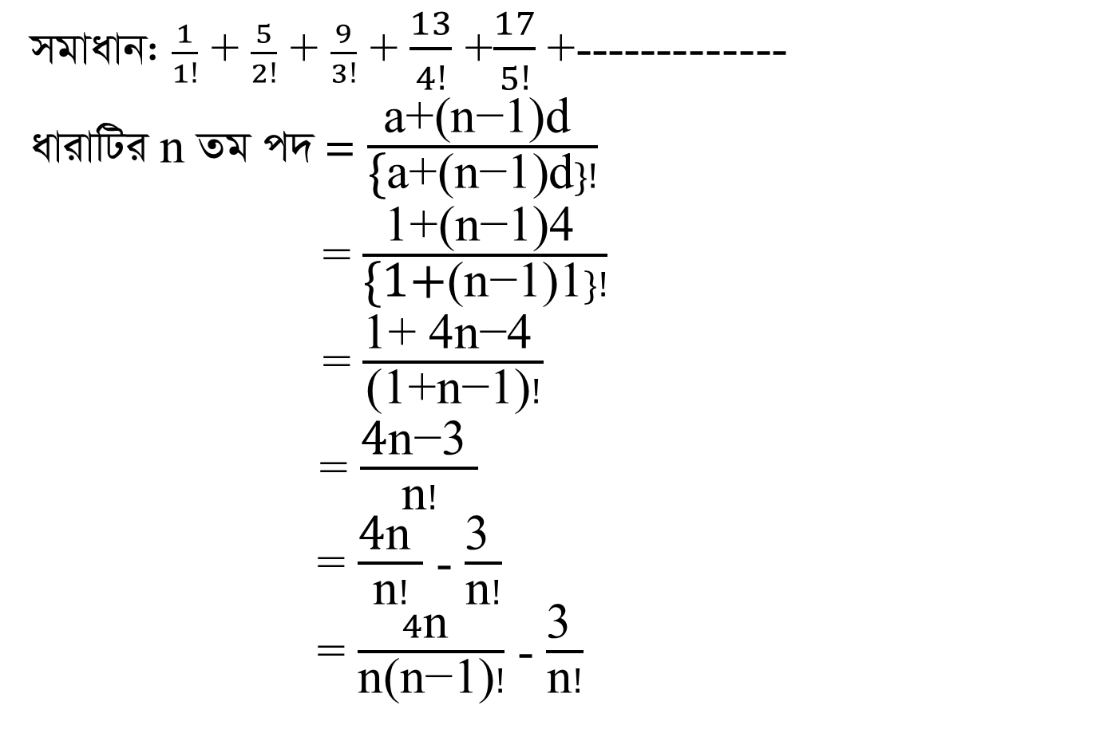
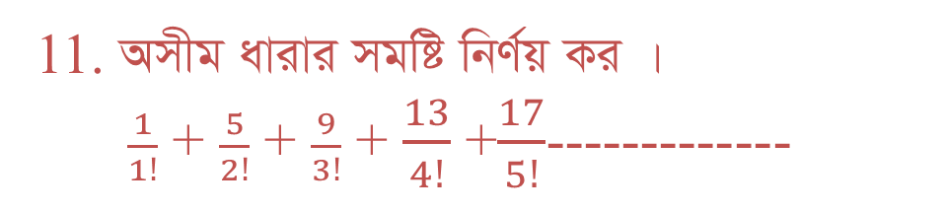
11.AmxgavivimgwówbY©qKi |
$\frac{1}{1!}$ + $\frac{5}{2!}$ + $\frac{9}{3!}$ + $\frac{13}{4!}$ +$\frac{17}{5!}$-------------
mgvavb: $\frac{1}{1!}$ + $\frac{5}{2!}$ + $\frac{9}{3!}$ + $\frac{13}{4!}$ +$\frac{17}{5!}$ +-------------
avivwUi n Zg c` = $\frac{\text{a}\text{+(}\text{n}\text{−1)}\text{d} }{\text{\{}\text{a}\text{+(}\text{n}\text{−1)}\text{d}\}!}$
= $\frac{\text{1+(}\text{n}\text{−1)4 }}{\text{\{1+}\text{(}\text{n}\text{−1)1}\}!}$
= $\frac{\text{1+ }\text{4}\text{n}\text{−4 }}{\text{(1+}\text{n}\text{−1)}!}$
= $\frac{\text{4}\text{n}\text{−3 }}{\text{n}!}$
= $\frac{\text{4}\text{n} }{\text{n}!}$ - $\frac{\text{3} }{\text{n}!}$
= $\frac{4\text{n} }{\text{n}\text{(}\text{n}\text{−1)}!}$ - $\frac{\text{3} }{\text{n}!}$

Slide 31
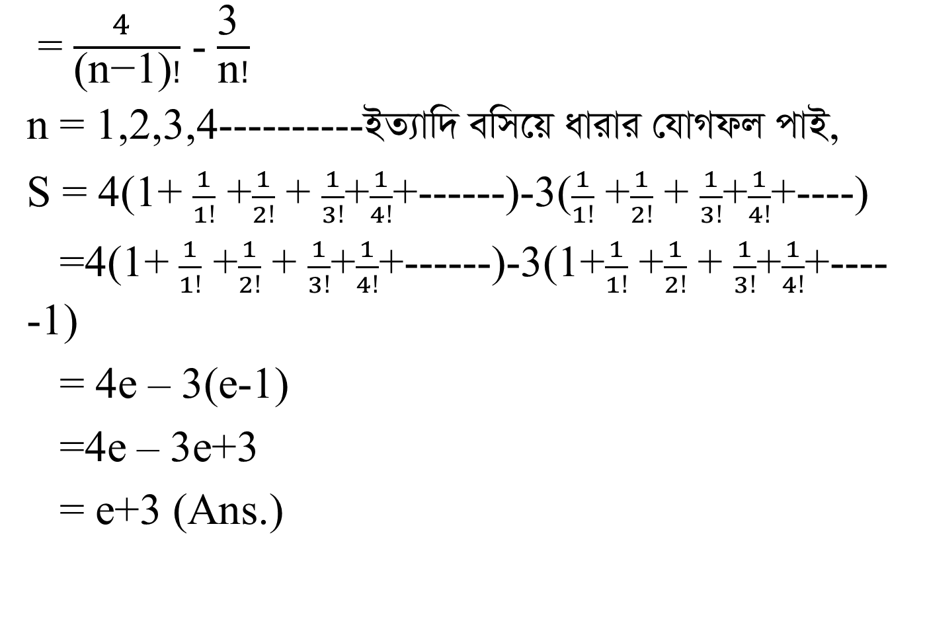
= $\frac{4 }{\text{(}\text{n}\text{−1)}!}$ - $\frac{\text{3 }}{\text{n}!}$
n = 1,2,3,4----------BZ¨vw` ewm‡qavivi †hvMdjcvB,
S = 4(1+ $\frac{1}{1!}$ +$\frac{1}{2!}$ + $\frac{1}{3!}$+$\frac{1}{4!}$+------)-3($\frac{1}{1!}$ +$\frac{1}{2!}$ + $\frac{1}{3!}$+$\frac{1}{4!}$+----)
=4(1+ $\frac{1}{1!}$ +$\frac{1}{2!}$ + $\frac{1}{3!}$+$\frac{1}{4!}$+------)-3(1+$\frac{1}{1!}$ +$\frac{1}{2!}$ + $\frac{1}{3!}$+$\frac{1}{4!}$+---- -1)
= 4e – 3(e-1)
=4e – 3e+3
= e+3 (Ans.)

Slide 32

ab¨ev`

