Slide 1
Phisics 2
Md Mukhlesur Rahman Kanon
B.Sc Hon’s M.Sc (Chemistry) M.Ed

Slide 2
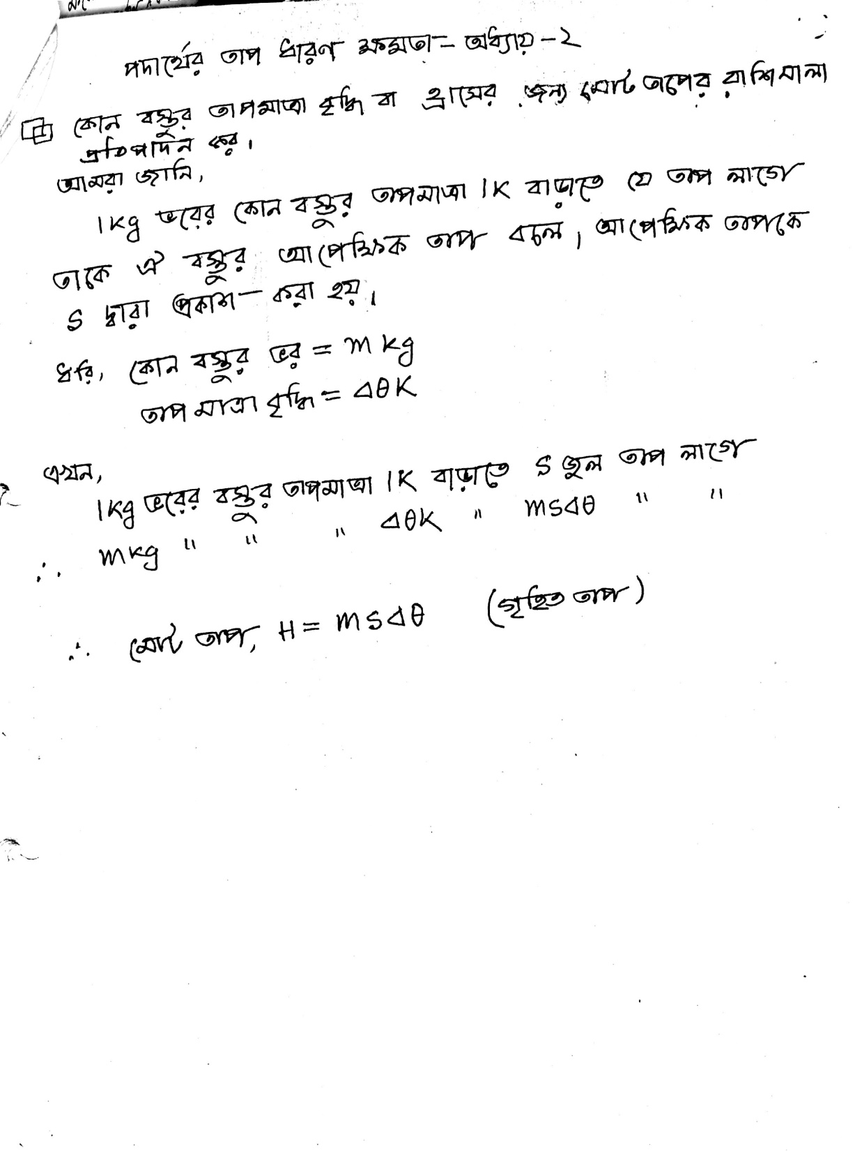

Slide 3
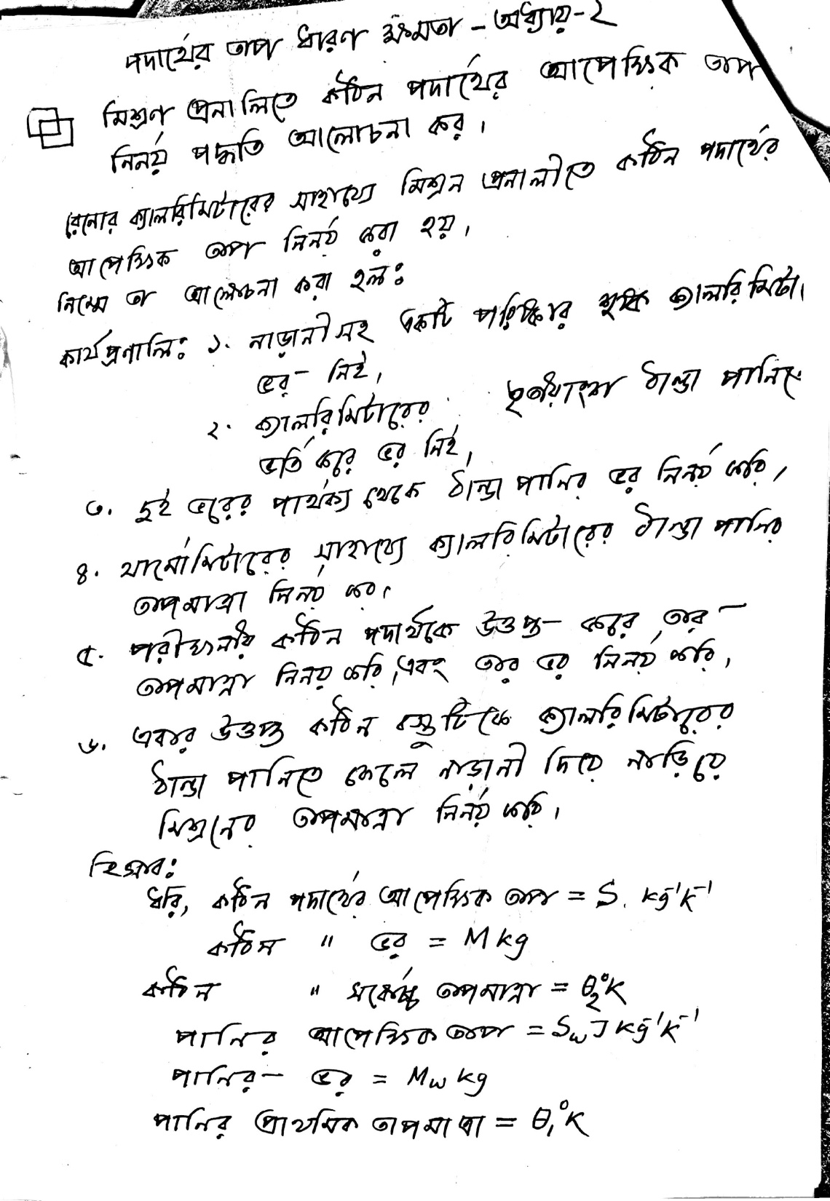

Slide 4
