Slide 1

Welcome to my session

Slide 2
শিক্ষক পরিচিতিঃ
অজিত কুমার দেবনাথ
চিফ ইন্সট্রাক্টর (নন-টেক)
বাংলাদেশ সার্ভে ইনস্টিটিউট
কুমিল্লা

Slide 3
আজকের পাঠ
অনির্দিষ্ট যোগজীকরণ
(Indefinite integrals)
অধ্যায় -১১

Slide 4
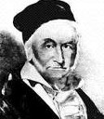
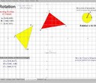
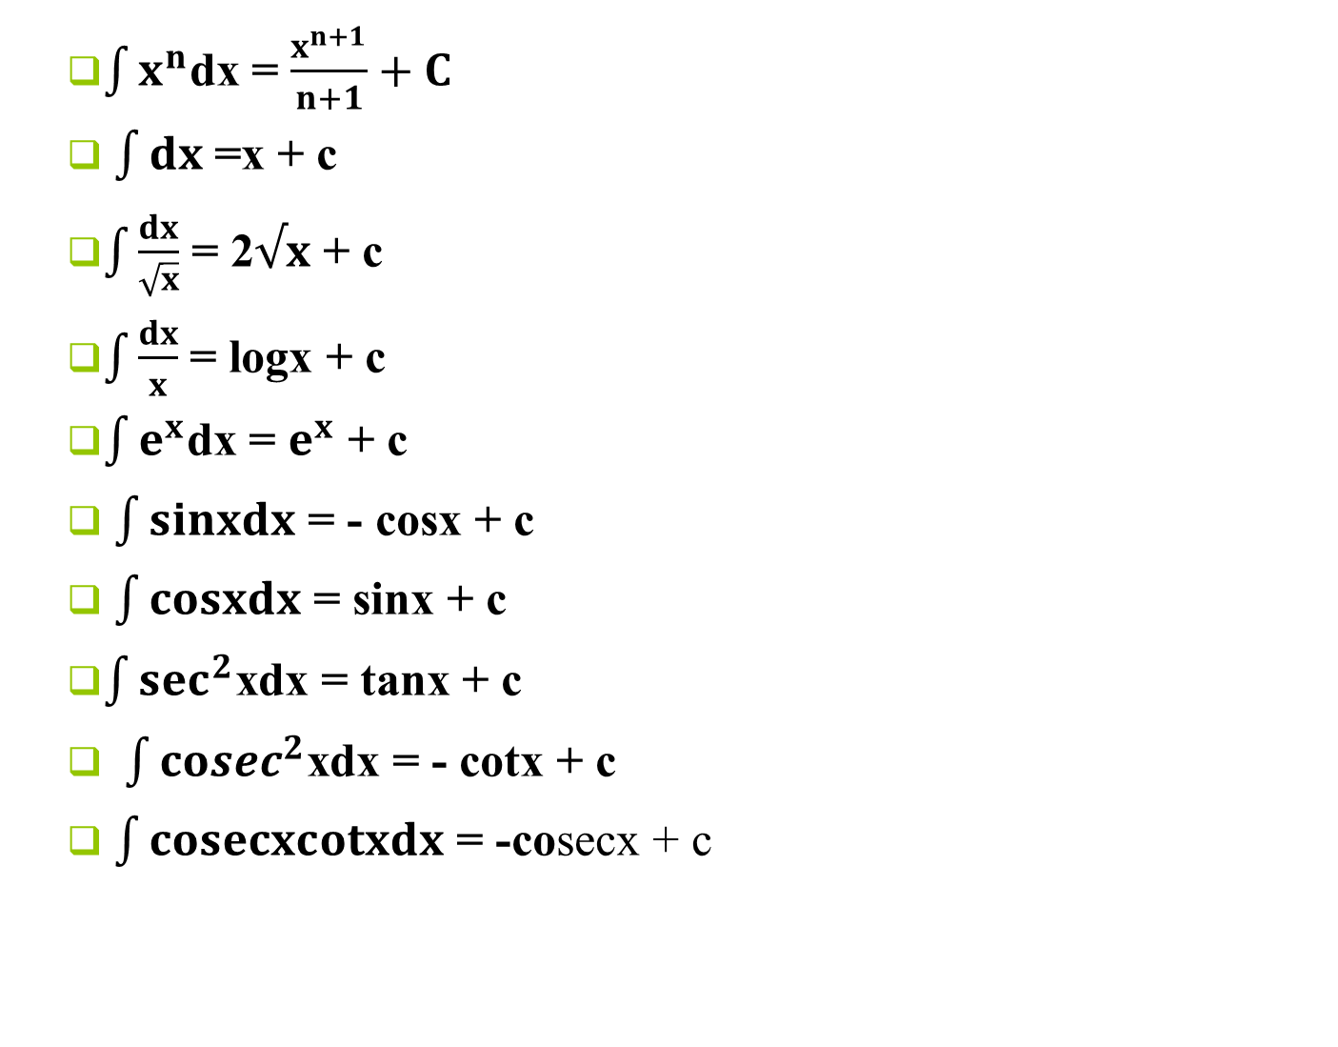
প্রয়োজনীয় সূত্র
$\int{x^{n}}$dx = $\frac{x^{n+1}}{n+1}+C$
$\int{dx}$ =x + c
$\int{\frac{dx}{\sqrt{x}}}$ = 2$√x$ + c
$\int{\frac{dx}{x}}$ = logx + c
$\int{e^{x}}$dx = $e^{x}$ + c
$\int{sinxdx}$ = - cosx + c
$\int{cosxdx}$ = sinx + c
$\int{\sec^{2}}$xdx = tanx + c
$\int{{cosec}^{2}}$xdx = - cotx + c
$\int{cosecxcotxdx}$ = -cosecx + c

Slide 5

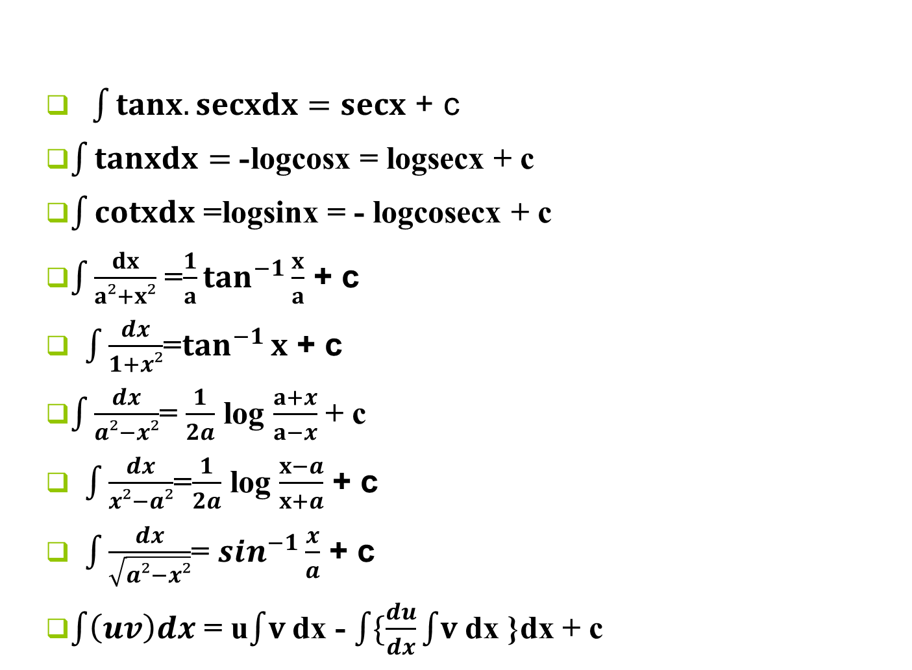
$\int{tanx.secxdx=secx}$ + c
$\int{tanxdx}=$- logcosx = logsecx + c
$\int{cotxdx}$= logsinx = - logcosecx + c
$\int{\frac{dx}{a²+x²}}$= $\frac{1}{a}\tan^{−1}{\frac{x}{a}}$ + c
$\int{\frac{dx}{1+x²}}$=$\tan^{−1}{x}$ + c
$\int{\frac{dx}{a²−x²}}$ =$\frac{1}{2a}$ log $\frac{a+x}{a−x}$ + c
$\int{\frac{dx}{x²−a²}}$=$\frac{1}{2a}$ log $\frac{x−a}{x+a}$ + c
$\int{\frac{dx}{\sqrt{a²−x²}}}$ =$\sin^{−1}{\frac{x}{a}}$ + c
$\int{\left(uv\right)dx}$ = u$\int{v }$dx - $\int{\{\frac{du}{dx}}\int{v }$dx }dx + c

Slide 6
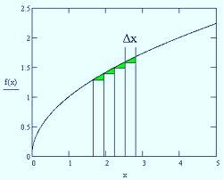
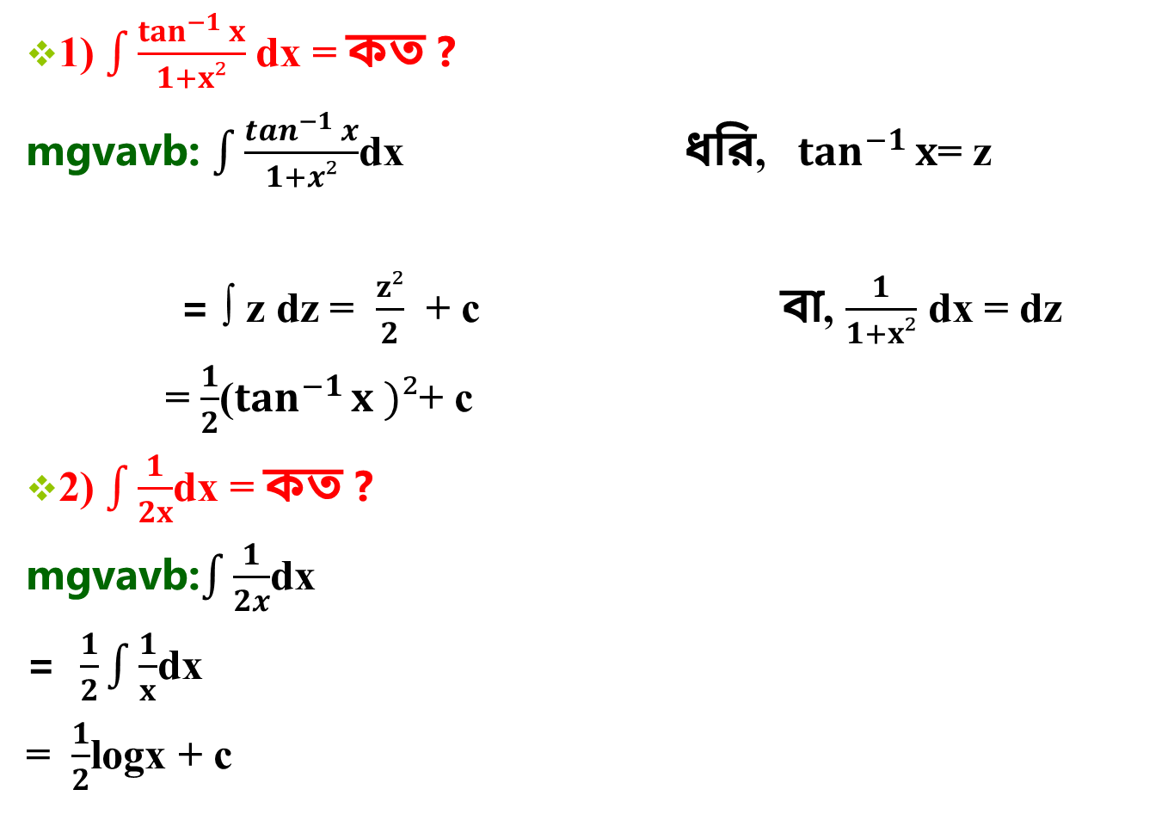
1) $\int{\frac{\tan^{−1}{x}}{1+x²}}$dx = কত ?
mgvavb: $\int{\frac{\tan^{−1}{x}}{1+x²}}$dx ধরি, $\tan^{−1}{x}$= z
= ∫ z dz = $\frac{z²}{2}$ + c বা, $\frac{1}{1+x²}$ dx = dz
= $\frac{1}{2}$($\tan^{−1}{x )²}$+ c
2) $\int{\frac{1}{2x}}$dx = কত ?
mgvavb:$\int{\frac{1}{2x}}$dx
= $\frac{1}{2}\int{\frac{1}{x}}$dx
= $\frac{1}{2}$logx + c

Slide 7


3) $\int{tan²xdx}$
= $\int{(sec²x−1)}dx$
= tanx – x + c (Ans)
4) $\int{\frac{tanx}{√2cotx}}$dx
= $\frac{1}{√2}\int{tanxtanxdx}$
= $\frac{1}{√2}\int{tan²xdx}$
$$\text{=}\frac{1}{√2}\int{(sec²x−1)}dx$$
$$\text{=}\frac{1}{√2}\text{[}\text{tanx} \text{– }\text{x}\text{ ]+ }\text{c}\text{ (}\text{Ans}\text{)}$$

Slide 8
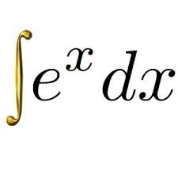
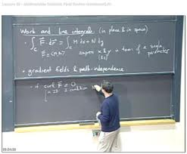
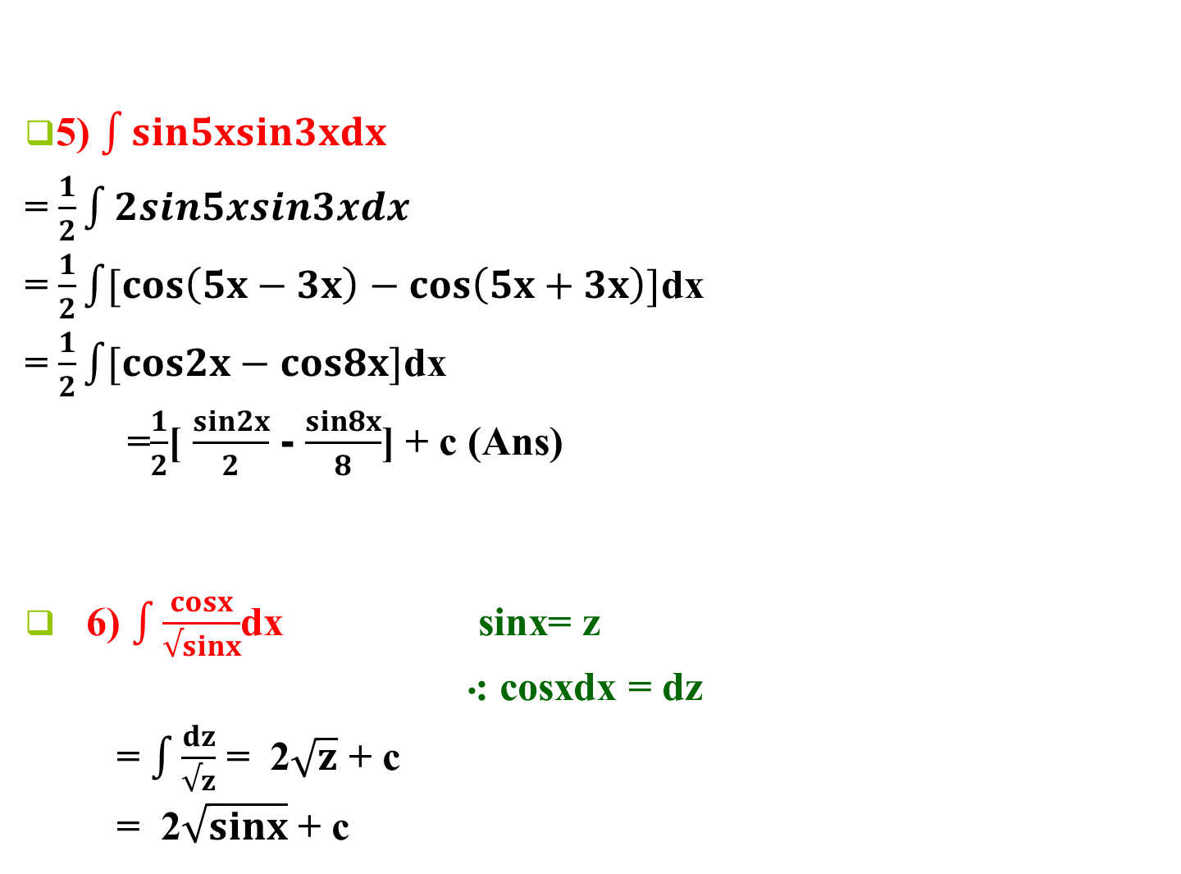
5) $\int{sin5xsin3xdx}$
= $\frac{1}{2}\int{2sin5xsin3xdx}$
= $\frac{1}{2}\int{[cos\left(5x−3x\right)−cos\left(5x+3x\right)]}$dx
= $\frac{1}{2}\int{[cos2x−cos8x]}$dx
=$\frac{1}{2}$[ $\frac{sin2x}{2}$ - $\frac{sin8x}{8}$] + c (Ans)
6) $\int{\frac{cosx}{√sinx}}$dx sinx= z
⁖ cosxdx = dz
= $\int{\frac{dz}{√z}}$ = 2$\sqrt{z}$ + c
= 2$\sqrt{sinx}$ + c

Slide 9

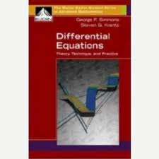
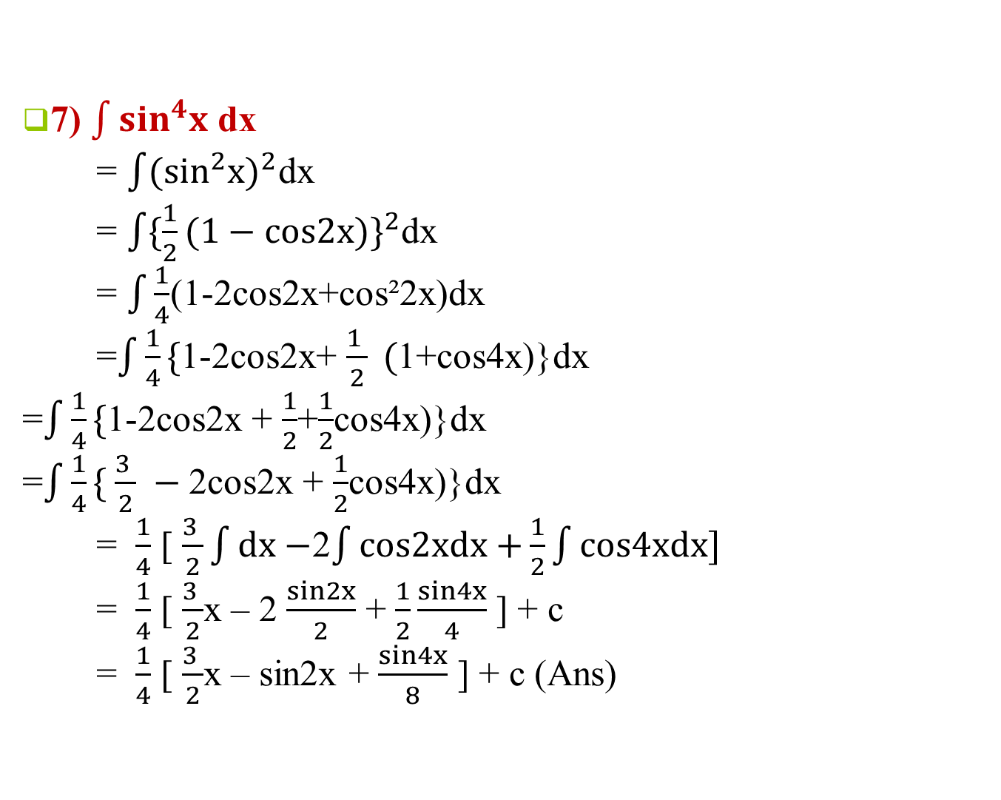
7) $\int{\sin^{4}x}$ dx
= $\int{({\sin^{2}x)}^{2}}$dx
= $\int{\{\frac{1}{2}({1−cos2x)\}}^{2}}$dx
= $\int{\frac{1}{4}}$(1-2cos2x+cos²2x)dx
=$\int{\frac{1}{4}}\{$1-2cos2x+ $\frac{1 }{2} ($1+cos4x)}dx
=$\int{\frac{1}{4}}\{$1-2cos2x + $\frac{1}{2}$+$\frac{1}{2}$cos4x)}dx
=$\int{\frac{1}{4}}\{ \frac{3 }{2} −$2cos2x + $\frac{1}{2}$cos4x)}dx
= $\frac{1}{4}$ [ $\frac{3 }{2}\int{dx−}$2$\int{cos2xdx+}\frac{1}{2}\int{cos4xdx]}$
= $\frac{1}{4}$ [ $\frac{3 }{2}$x – 2 $\frac{sin2x}{2}$ + $\frac{1}{2}\frac{sin4x}{4}$ ] + c
= $\frac{1}{4}$ [ $\frac{3 }{2}$x – sin2x + $\frac{sin4x}{8}$ ] + c (Ans)

Slide 10
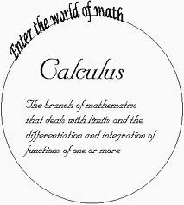
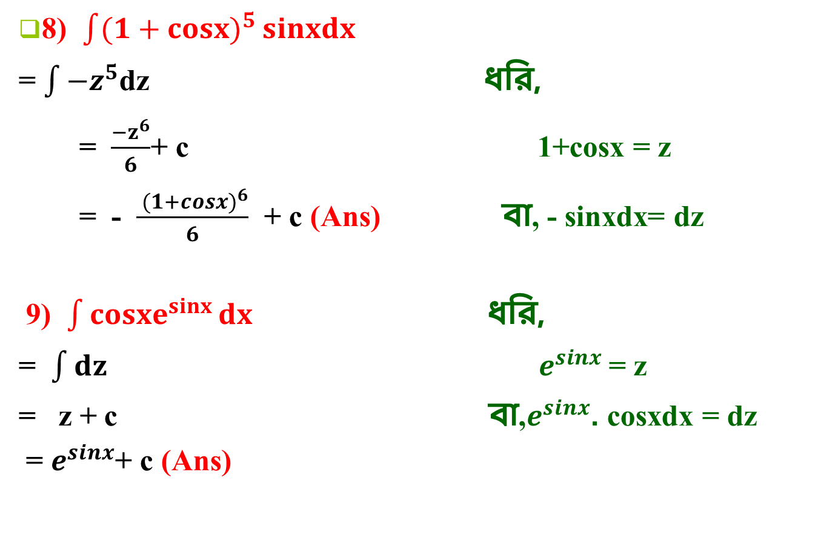
8) $\int{{(1+cosx)}^{5}}sinxdx$
= $\int{−z^{5}}$dz ধরি,
= $\frac{{−z}^{6}}{6}$+ c 1+cosx = z
= - $\frac{{ (1+cosx)}^{6}}{6}$ + c (Ans) বা, - sinxdx= dz
9) $\int{{cosxe}^{sinx}}dx$ ধরি,
= $\int{dz}{ e}^{sinx}$= z
= z + c বা,$e^{sinx}$. cosxdx = dz
= $e^{sinx}$+ c (Ans)

Slide 11
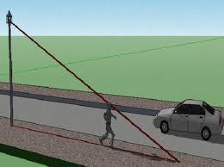
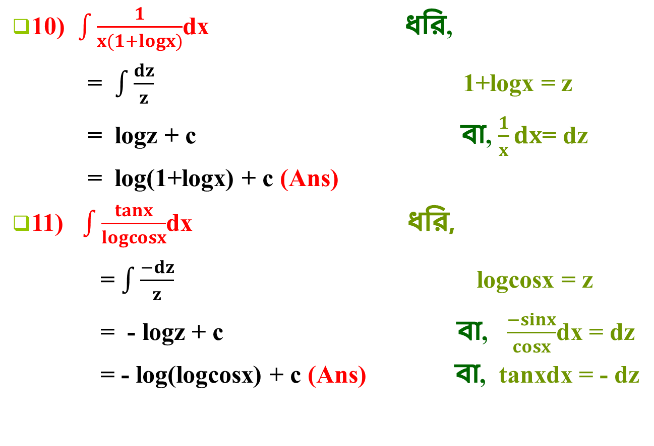
10) $\int{\frac{1}{x(1+logx)}}$dx ধরি,
= $\int{\frac{dz}{z}}$ 1+logx = z
= logz + c বা, $\frac{1}{x}dx$= dz
= log(1+logx) + c (Ans)
11) $\int{\frac{tanx}{logcosx}}$dx ধরি,
= $\int{\frac{−dz}{z}}$ logcosx = z
= - logz + c বা, $\frac{−sinx}{cosx}$dx = dz
= - log(logcosx) + c (Ans) বা, tanxdx = - dz

Slide 12
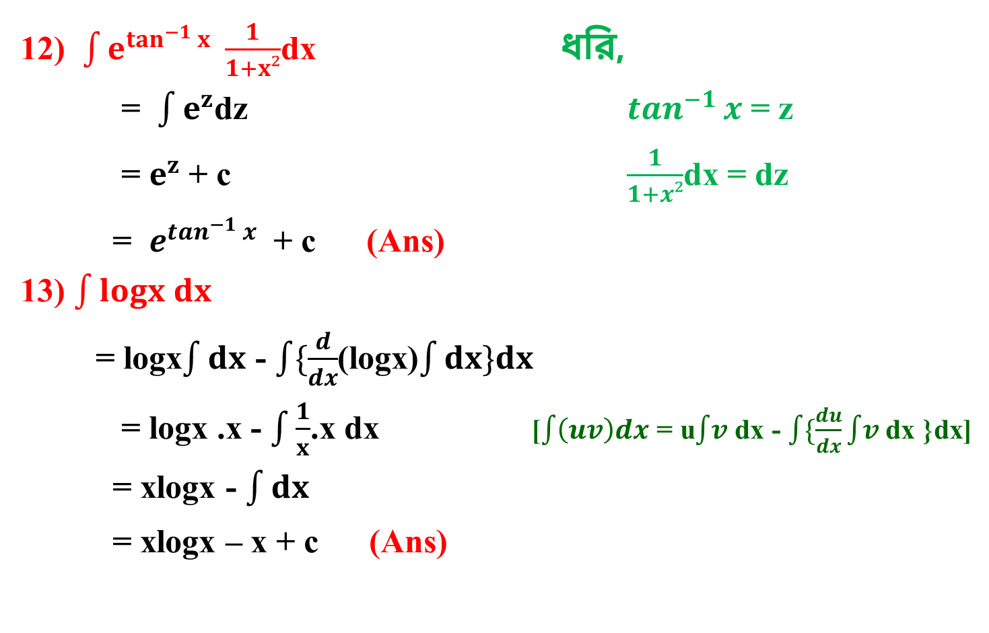
12) $\int{e^{\tan^{−1}{x}} \frac{1}{1+x²}}$dx ধরি,
= $\int{e^{z}}$dz $\tan^{−1}{x}$ = z
= $e^{z}$ + c $\frac{1}{1+x²}$dx = dz
= $e^{\tan^{−1}{x}}$ + c (Ans)
13) $\int{logx dx}$
= logx$\int{dx}$ - $\int{\{\frac{d}{dx}}$(logx)$\int{dx\}dx}$
= logx .x - $\int{\frac{1}{x}}$.x dx [$\int{\left(uv\right)dx}$ = u$\int{v }$dx - $\int{\{\frac{du}{dx}}\int{v }$dx }dx]
= xlogx - $\int{dx}$
= xlogx – x + c (Ans)

Slide 13

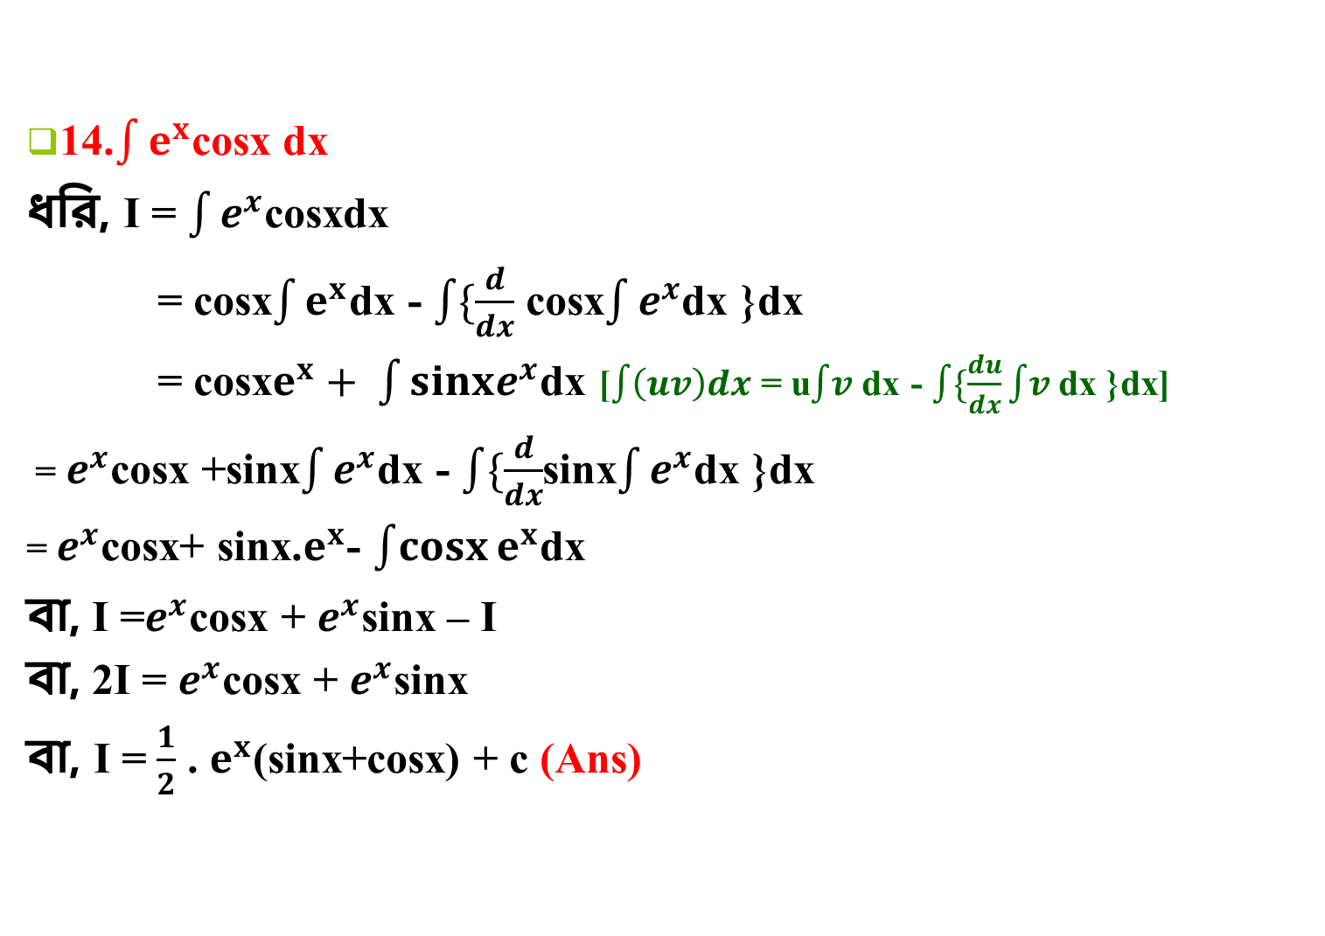
14.$\int{e^{x}}$cosx dx
ধরি, I = $\int{e^{x}}$cosxdx
= cosx$\int{e^{x}}$dx - $\int{\{\frac{d}{dx}}$ cosx$\int{e^{x}}$dx }dx
= cosx$e^{x}+ \int{sinxe^{x}}$dx [$\int{\left(uv\right)dx}$ = u$\int{v }$dx - $\int{\{\frac{du}{dx}}\int{v }$dx }dx]
= $e^{x}$cosx +sinx$\int{e^{x}}$dx - $\int{\{\frac{d}{dx}}$sinx$\int{e^{x}}$dx }dx
= $e^{x}$cosx+ sinx.$e^{x}$- $\int{cosx}e^{x}$dx
বা, I =$e^{x}$cosx + $e^{x}$sinx – I
বা, 2I = $e^{x}$cosx + $e^{x}$sinx
বা, I = $\frac{1}{2}$ . $e^{x}$(sinx+cosx) + c (Ans)

Slide 14
বাড়ির কাজ
তোমার বইয়ের আলোচ্য সংক্লিষ্ট বিভিন্ন নিয়মের কমপক্ষে দুটি করে
সমস্যার সমাধান করবে।

Slide 15
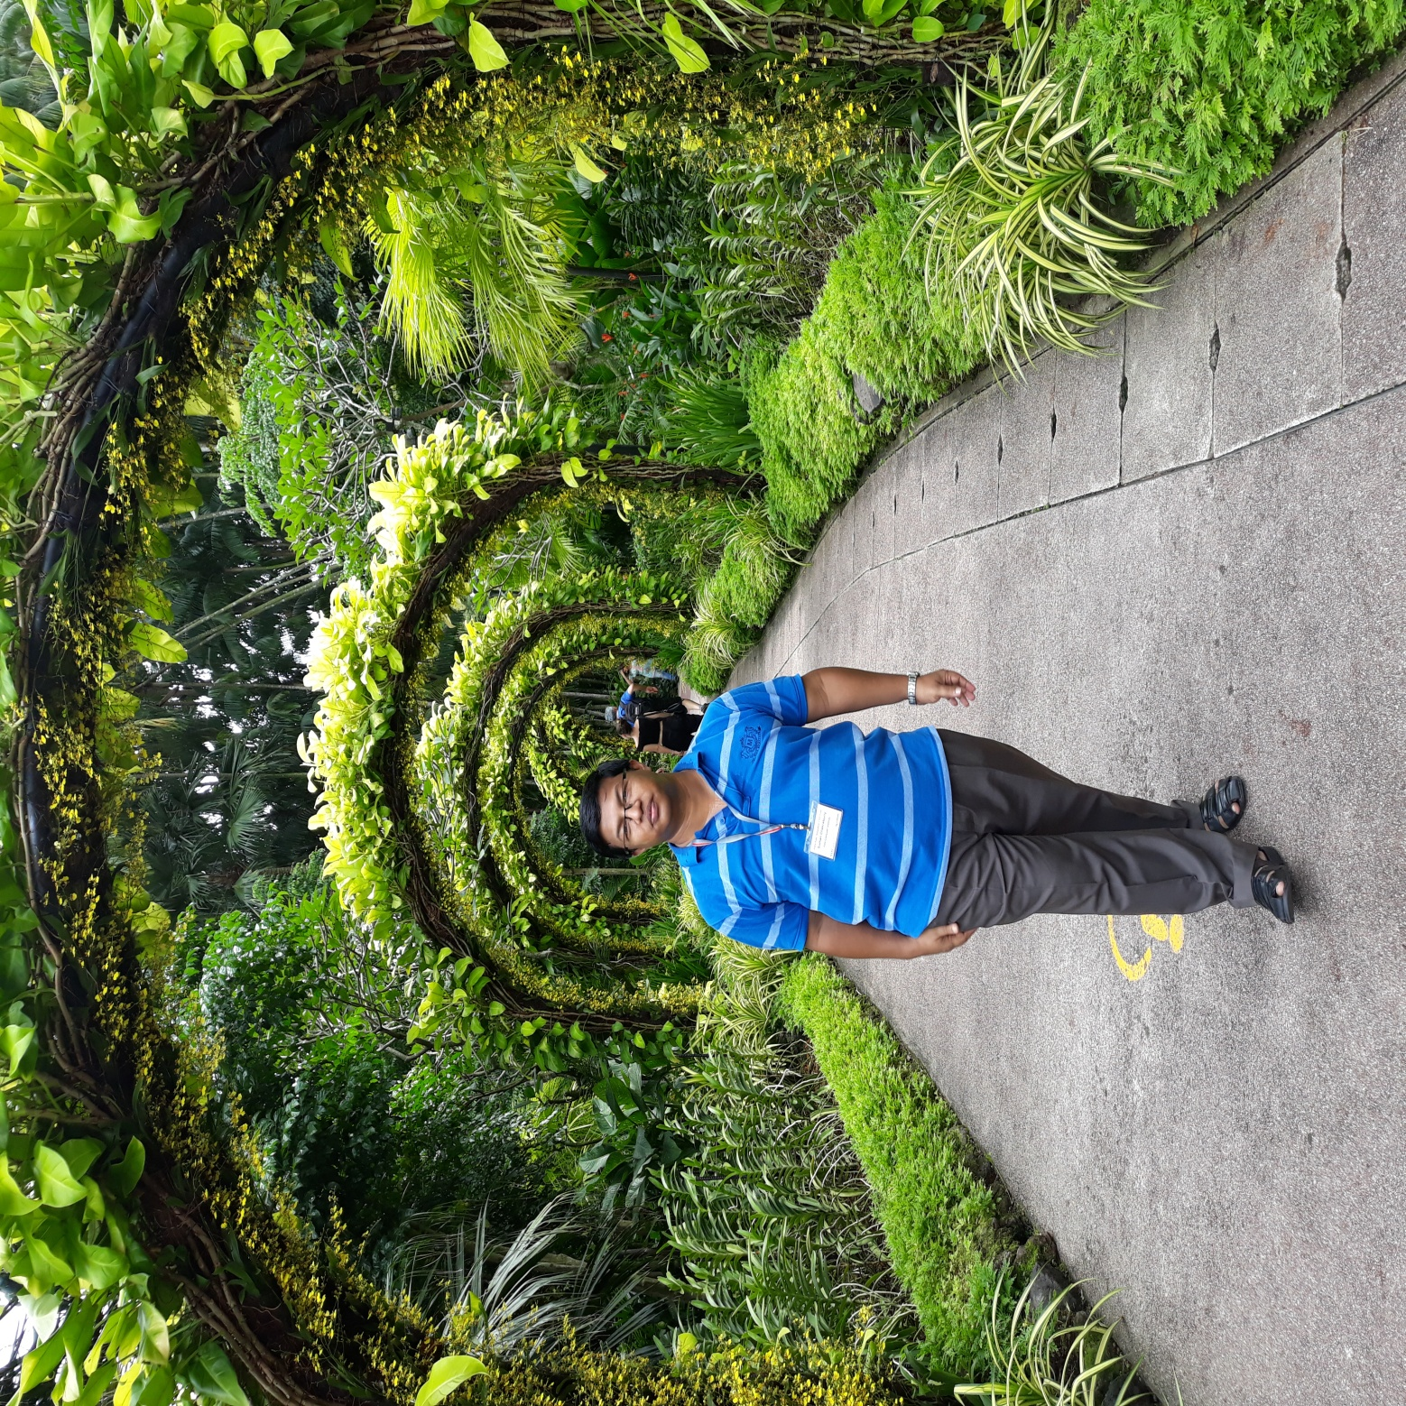
THANKS

